Slide 1
Towards Constructing GRSF
FORTH-ICS
Yannis Tzitzikas, Yannis Marketakis, Nikos Minadakis
{tzitzik|marketak|minadakn}@ics.forth.gr
BlueBRIDGE 1st Review
January 5, 2017
Brussels, Belgium

Slide 2
Outline
Overview
Sources & Main Entities
Semantic Models
Mappings
Components and Services
GRSF construction
GRSF as a product
Next Steps

Slide 3
Overview
Support the production of reliable stock and fisheries information.
(taken from the DoA)
T5.2: Global record of Stocks and Fisheries VRE:
This task aims to produce a collaborative environment to maintain a global knowledge Base of stocks and fisheries.
Collect existing datasets on stocks and fisheries into a managed ontology-based knowledge base.
Identify additional datasets/data sources to enrich the stocks and fisheries with required inputs and bringing those into the infrastructure.
Deliver a number of tools by extending and revising existing platforms.
Deliver services to expose stocks and fisheries identifiers and connected information to external clients as Linked Open Data.

Slide 4
Objectives / Expectations
Construction of a global knowledge base of stocks and fisheries:
Integrating heterogeneous data
Publishing data according to LOD principles
Connecting data
Exposing stocks and fisheries data
Enabling complex query answering
Building tools and web applications that will exploit the knowledge base

Slide 5
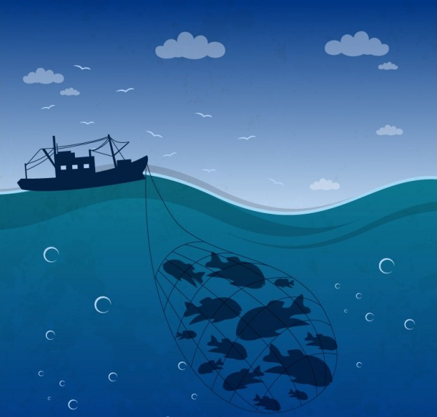
Main Entities
Fishery is an activity leading to the harvesting of fish, within the boundaries of a defined water area. It gathers indication of human fishing activity with economic, management, biological, environmental and technological viewpoints.
Stock is a group of individuals of a species occupying a well defined spatial range independent of other stocks of the same species

Slide 6
Sources
FAO FIRMS (http://firms.fao.org/firms/en)
Fisheries and Resources Monitoring System
Provides access to high-quality information on the global monitoring and management of fishery marine resources.
Collects data from 14 intergovernmental organizations
RAM Legacy Stock Assessment Database (http://ramlegacy.org/)
A compilation of stock assessment results for commercially exploited marine populations from around the world.
The assessments were assembled from 21 national and international management agencies.
FishSource (http://www.fishsource.com/)
Online information resource about the status of stocks and fisheries.
Compiles and summarizes all the information that is needed from analysts to evaluate the sustainability.

Slide 7
Minimum Data Requirements
Stocks
Stock ID
Stock Name
Species
Assessment Area
Type
Exploiting Fisheries
Reporting Entity
Assessment Methods
State and Trend
Scientific Advice
Fishing Pressure
Abundance Level
DB Source
Source of Information
Ownership
Reporting Year
Fisheries
Fishery ID
Fishery Name
Species
Fishing Area
Jurisdiction Area
Type
Exploiting stocks
Management Entity
Production System Type
Flag State
Fishing Gear
Catches and Landings
DB Source
Source of Information
Ownership
Reporting Year
Minimum data requirements for the GRSF were defined by the community.
17 fields for stocks and 17 fields for fisheries, UUID specifications and usage scenarios were defined.
Information from the 3 sources has to be extracted, transformed and stored to the GRSF according to the requirements.

Slide 8
Semantic Models Marine TLO
MarineTLO is a Top Level Ontology for the marine domain offering fundamental abstractions for querying.
It was created for the needs of iMarine FP7 project.
Marine TLO is being extended to according to the BlueBridge project requirements and is being used as conceptual backbone for information integration in the knowledge base.
The latest “core” version of MarineTLO (v.5) was released on December 2016, contains x classes and x properties, aims at covering any part of the marine domain.
The latest “operational” version for the needs of BlueBridge project (v.5) aims at integrating FIRMS, FishSource and RAM. It contains the “core” version and classes/properties related to the particular sources used. In total it contains x classes and x properties.

Slide 9
Semantic Models Extensions
5 new Classes added.
12 new Properties added.
5 new Classes
3 new Events
6 new properties (and the corresponding inverse ones)
BC75_Stock
LC55_used_object_of_type
Fishery Activity
BC76_Stock_Formation
LC56_has_preferred_identifier
Capture Activity
LC57_used_specific_technique
BC77_Matter_Removal
LC58_right_held_by
Data Evaluation
LC59_is_subject_to
BC78_Ammount_or_Matter
LC60_possesses
BC79_Rights

Slide 10
Semantic Models Modeling Stock example
BC32 Identifier
ALB+ALB_S
LX3 has type
E55 Type FIGIS Identifier
E55 Type
Assessment Unit
LC1 is identified by
LX3 has type
BT27 Species
ALB
LX has preferred identifier
BC30 Appellation
Thunnus Alalunga
LX exemplifies
BC75 Stock Albacore South Atlantic
LC occupied
BC15 Water Area ALB_S
LC1 is identified by
BC30 Appellation
South Atlantic
LC19 has dimension
Number
0.92
LC20 has value
LC2 is referred to by
BC5 Dimension
SSB of Stock 4
LC21 has unit
BC55 Measurement Unit
BMSY
LX3 has type
Dimension Type??
Abundance Level
BC27_Publication http://www.iccat.int/Documents
/BienRep/REP_EN_12-13_II_2.pdf
LC has current or former owner
BC8 Actor
ICCAT

Slide 11
Semantic Models Modeling Fishery example
BC32 Identifier
4
LX3 has type
E55 Type FIGIS Identifier
Type
Fishing Activity
LC1 is identified by
LX3 has type
BT27 Species
CCE
LX has preferred identifier
BC30 Appellation
Carcharhinus leucas
LX exemplifies
BC62 Capture Activity Shark Fisheries
O15 occupied
BC15 Water Area THA
LC1 is identified by
BC30 Appellation
Thailand
P125 used object of type
BT11 Equipment Type
OT
LX1 is identified by
BC30 Appellation
Otter trawls
LC2 is referred to by
LX exemplifies
BC27 Publication
Report of Shark Fisheries
in Thailand
LC has current or former owner
BC8 Actor
SEAFDEC
BT27 Species
CCV
LX has preferred identifier
BC30 Appellation
Carcharhinus perezi

Slide 12
Mappings
Data from the underlying sources are expressed using different models or even formats
We need a framework to support the mappings between the original sources and MarineTLO as well the transformation of the corresponding data.
fi:AqRes
BC Stock
“related with”
LX exemplifies
fi:SpeciesRef
BT27 Species

Slide 13
Components Mapping Framework
X3ML mapping definition language
XML based language which describes schema mappings to be collaboratively created and discussed by experts.
X3ML was designed in FORTH
Emphasizes on establishing a standardized mapping description.
X3ML Engine
Realizes the transformation of the source records to the target format.
Takes as input the source data, the description of the mappings in the X3ML mapping definition file and the URI generation policy file.
Transforms the source document into a valid RDF document.
3M Editor
Web application to assist users during the mapping definition process.

Slide 14
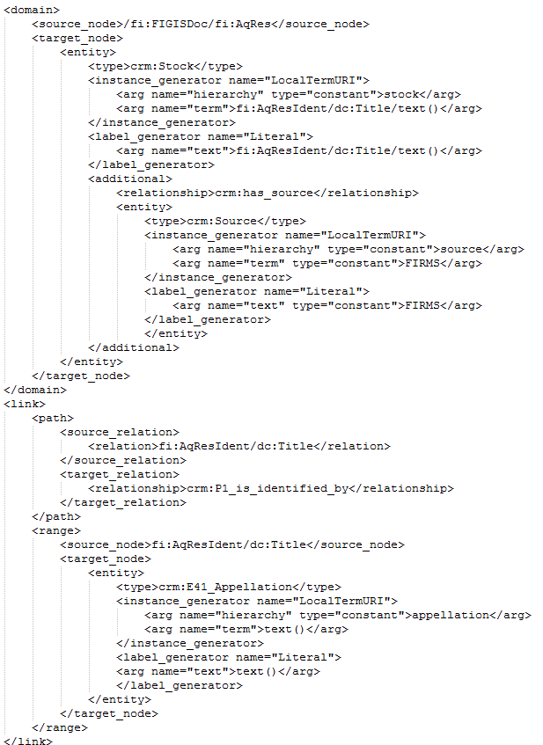
Mapping Activities
x3ml mapping files created for:
FIRMS stocks
FIRMS fisheries
RAM stocks
FishSource stocks
FishSource fisheries
11 New generator policies.
x3ml engine modifications/extensions.
Shortcuts for efficiency improvement.
Interface and actions specifications.

Slide 15
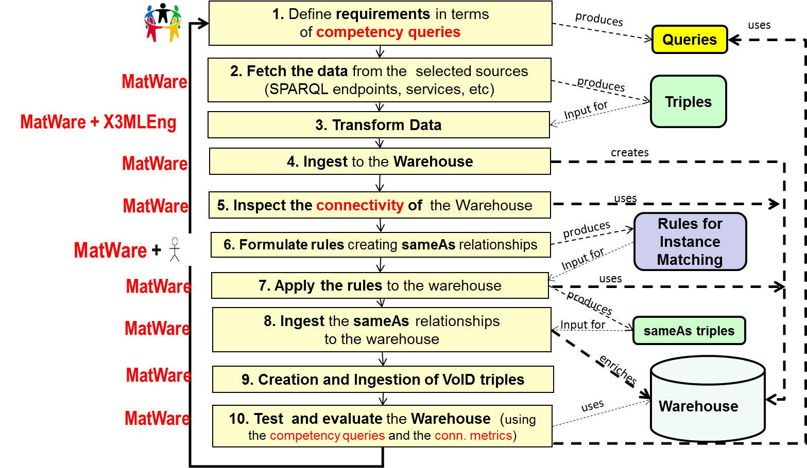
Components MatWare
MatWare is a tool that automates the construction and evaluation of the connectivity of a semantic warehouse

Slide 16
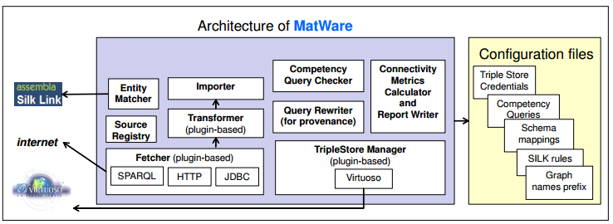
Components MatWare – cont’d
The Process:
Downloads and transforms data from remote sources.
Ingests them into semantic repositories (i.e. Virtuoso triplestore).
Applies transformation rules, and creates sameAs links to assist complex query answering.
Computes several quality metrics as regards the connectivity of the warehouse.
Refreshes the warehouse if the data derived from remote sources change.

Slide 17
Components GRSF-services-core Merger & Dissector
Creates the GRSF’s records by merging (and dissecting for the case of fisheries) the source’s records according to matching (and dissection) rules.
Realizes the source’s priority rules (FIRMS>FishSource>RAM).
Creates the URIs of the GRSF Records.
Creates the GRSF Record’s Semantic IDs and Semantic Titles.
Checks and Updates the Traceability Flags.
Imports the GRSF Records to the GRSF Knowledge Base.
Updates the source’s records to refer to their GRSF parent records.
GRSF
Records
GRSF KB
GRSF-services-core-Merger&Dissector
FIRMS same-as
RAM
FIRMS same-as
FishSource
RAM same-as
FishSource
GRSF KB
MatWare - Importer
MatWare - SilkLink
FIRMS Records
RAM
Records
FishSource Records
GRSF KB

Slide 18
Merging and Dissecting
Stocks’ matching rule: If two stocks have the
same species
same water areas
then these stocks are the same.
Fisheries’ matching rule: If two fisheries have the
same species
same fishing areas
same jurisdiction area
same management unit
same fishing gear
same flag state
same production system type
then these two fisheries are the same.
Priority rule: For time indepentent information FIRMS > FishSource > Fisheries
Dissection rule: Dissecting source’s fisheries records by a) species, b) fishing gear, c) flag state, d) production system type.
Water Area
Water Area
Indicators
Indicators
FIRMS Stock
FishSource Stock
Species
Species
Indicators
GRSF
Stock
Indicators
Species
Water Area

Slide 19
Merging and Dissecting
Stocks’ matching rule: If two stocks have the
same species
same water areas
then these stocks are the same.
Fisheries’ matching rule: If two fisheries have the
same species
same fishing areas
same jurisdiction area
same management unit
same fishing gear
same flag state
same production system type
then these two fisheries are the same.
Priority rule: For time independent information FIRMS > FishSource > Fisheries
Dissection rule: Dissecting source’s fisheries records by a) species, b) fishing gear, c) flag state, d) production system type.
Fishing Area 1
Fishing Area 2
FIRMS Fishery
Species 1
Species 2
Water Area 2
GRSF
Fishery 1
Species 1
Water Area 1
Species 2
GRSF
Fishery 2
Water Area 2
Water Area 1

Slide 20
Components GRSF-services-core Publisher
Fetches Stock and Fishery records from the GRSF KB
Records from the original sources
Records from the GRSF source
Publishes the records in the GRSF VRE catalogue
Updates the GRSF KB with the GRSF catalog ID and URL
GRSF
Records
GRSF VRE
GRSF-services-core-Publisher
GRSF KB
Records
GRSF KB

Slide 21
Components GRSF-services-updater
Updates the status of a GRSF record (Stock or Fishery)
Pending, Approved, Rejected
Annotates a GRSF record with a narrative message
i.e. a justification in the case of record rejection
Re-Publish the GRSF record (if it is approved) in the GRSF VRE for public use
GRSF KB
Records
GRSF KB
GRSF-services-updater
GRSF
Records
GRSF VRE

Slide 22
GRSF Construction GRSF KB Construction Workflow
GRSF
KB Records
GRSF KB
grsf records creation
(MatWare) GRSF-services-core-Merger&Dissector
matching rules
FIRMS Records
RAM
Records
FishSource Records
GRSF KB
(MatWare) Importer
transformed FIRMS records
transformed RAM records
transformed FishSource records
(MatWare) x3mlEngineTranformation
data importing
x3ml mappings
+ uri generators
(MatWare) TransformersToXML
FIRMS
RAM
FishSource
LocalSources

Slide 23
GRSF Construction GRSF Catalogue Publishing Workflow
GRSF catalogue
GRSF Public VRE
records publishing
GRSF-services-updater
GRSF
Admin catalogue
GRSF Admin VRE
GRSF records to JSON objects
records curation
(MatWare) GRSF-services-core-Publisher
GRSF
RDF records
GRSF
KB Records
GRSF KB

Slide 24
Provenance
Source produced uri suffix:
http://www.bluebridge-vres.eu/firms/stock/Toothfish%20-%20Eastern%20Ross%20Sea
“refers to” relationship:
Factsheet and Source of information fields:
Database Source field
CKAN catalogue field:
GRSF record
refers to
Source
record
BC Stock Albacore South Atlantic
LC2 is referred to by
BC27_Publication http://www.iccat.int/Documents
/BienRep/REP_EN_12-13_II_2.pdf
stock | type | source | factsheet
Northern Bluefin tuna - Western Atlantic | Assessment Unit | FIRMS | http://firms.fao.org/fishery/xml/resource/10015/en

Slide 25
GRSF as a product The contents of GRSF KB
 | GRSF | FIRMS | FishSource | RAM
Resources/Assessment Units | 2189 | 492 | 873 | 989
Fishery Activities/Descriptions | 7427 | 190 | 2203 | -
Species | 1204 | 578 | 389 | 264
Water Areas | 1181 | 264 | 302 | 636
Gears | 97 | 40 | 59 | -
Flag States | 163 | 69 | 96 | -
Assessment Methods | 110 | 58 | - | 74
Scientific Advices | 506 | 243 | 326 | -

Slide 26
GRSF as a product The contents of GRSF KB – cont’d
2190 Resources
/ Assessment Units
7712 Fishery
Activities/Descriptions
1204 Species
1181 Areas
97 Gears
163 FlagStates
110 Assessment Methods
506 Scientific Advices

Slide 27
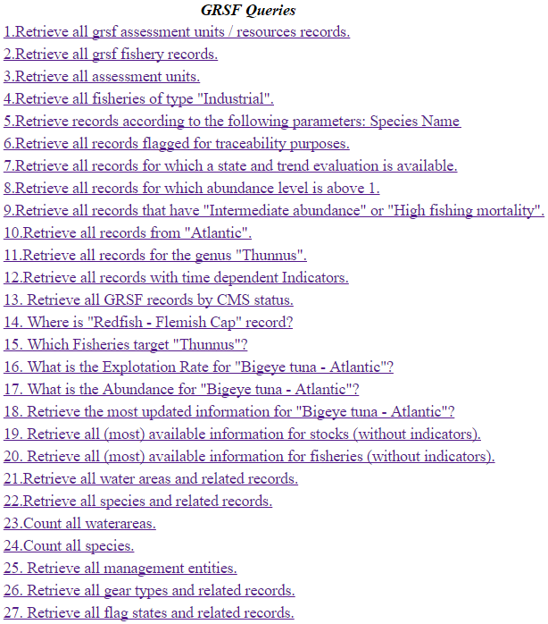
GRSF as a product Indicative Competency Queries
108 Total Queries
34 Competency Queries
37 FIRMS Queries
26 FishSource Queries
11 RAM Queries
Can be tested at:
https://i-marine.d4science.org/group/ grsf_admin/grsf-competency-queries

Slide 28
GRSF as a product Indicative Competency Queries – cont’d
Retrieve records according to Species Name / Area / Production System Type/ Flag State / Fishing Gear
fishery | species | Fishing area | Management entity | production_ system_type | flag_state | fishing_gear | factsheet
Sparidentex hasta Gulf subarea Bahrain Bahrain Hooks and lines Bahrain Artisanal | Sparidentex hasta | Gulf subarea | Public Commission for The Protection of Marine Resources, Environment and Wild Life. | Artisanal | Bahrain | Hooks and lines | http://firms.fao.org/fishery/xml/fishery/671/en
Istiophorus platypterus Gulf subarea Iran Gillnets Iran Artisanal | Istiophorus platypterus | Gulf subarea | Iran Fisheries Organization | Artisanal | Iran | Gillnets | http://firms.fao.org/fishery/xml/fishery/691/en
Makaira indica Gulf subarea Iran Hooks and lines Iran Artisanal | Makaira indica | Gulf subarea | Iran Fisheries Organization | Artisanal | Iran | Hooks and lines | http://firms.fao.org/fishery/xml/fishery/690/en
Stolephorus indicus Gulf subarea Iran Iran Fisheries Organization Iran Pair seines Iran Artisanal | Stolephorus indicus | Gulf subarea | Iran Fisheries Organization | Artisanal | Iran | Pair seines | http://firms.fao.org/fishery/xml/fishery/694/en

Slide 29
GRSF as a product Indicative Competency Queries – cont’d
Where is "Redfish - Flemish Cap" stock?
record | area | factsheet
Redfish - Flemish Cap | Atlantic, Northwest / 21.3.M | http://firms.fao.org/fishery/xml/resource/10318/en
What is the Explotation Rate for "Bigeye tuna - Atlantic"?
value | stock | year | indicator_or_unit | factsheet
0.369 | Bigeye tuna - Atlantic Ocean | 1973 | ratio_F_Fmsy | https://www.fishsource.org/stock_page/708
0.301 | Bigeye tuna - Atlantic Ocean | 1972 | ratio_F_Fmsy | https://www.fishsource.org/stock_page/708
0.56 | Bigeye tuna - Atlantic Ocean | 1985 | ratio_F_Fmsy | https://www.fishsource.org/stock_page/708

Slide 30
GRSF as a product GRSF Catalogue
Found in the following Stock Assessment VREs
GRSF_Admin (only for user with administrative permissions
https://services.d4science.org/group/grsf_admin/
GRSF (for public use)
https://services.d4science.org/group/grsf
It is based on the new CKAN-based catalogue (offered by Blue Commons)

Slide 31
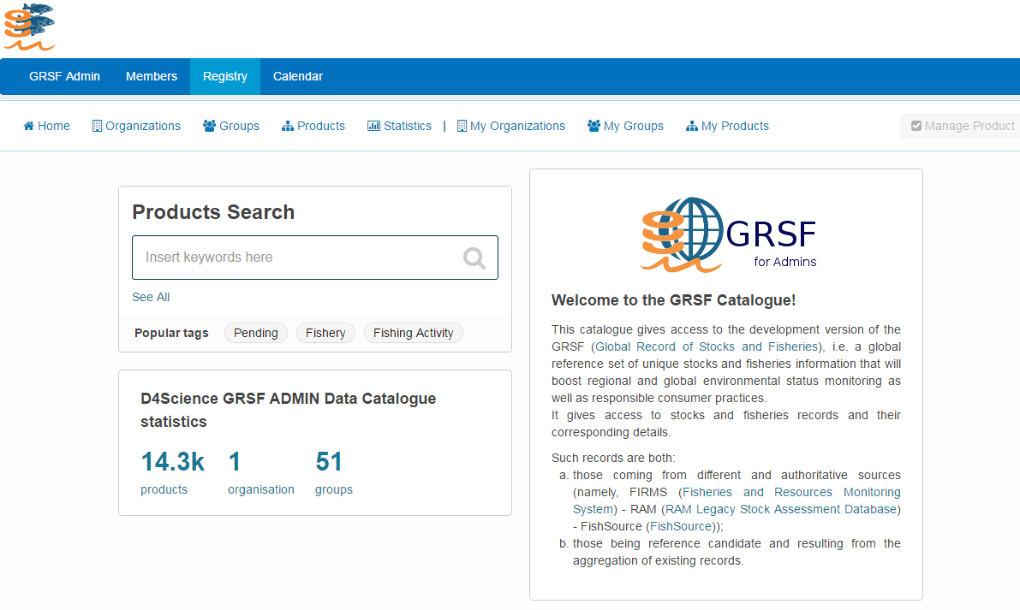
GRSF as a product GRSF Catalogue – cont’d

Slide 32
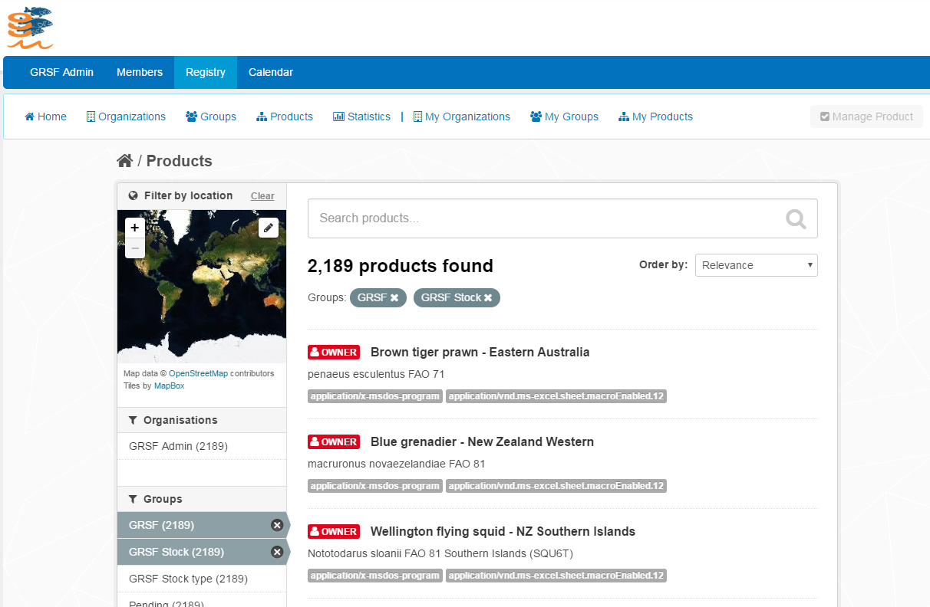
GRSF as a product GRSF Catalogue – cont’d

Slide 33
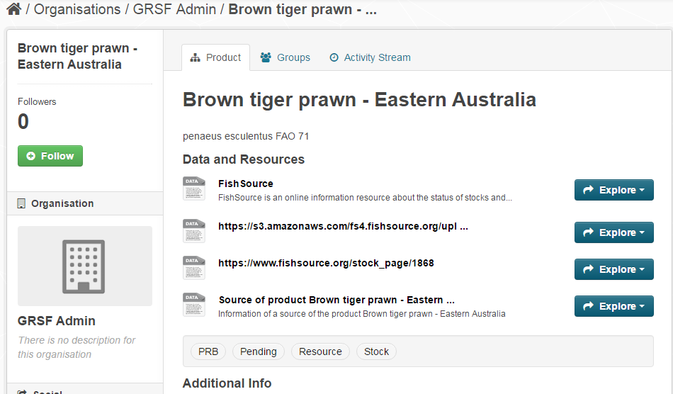
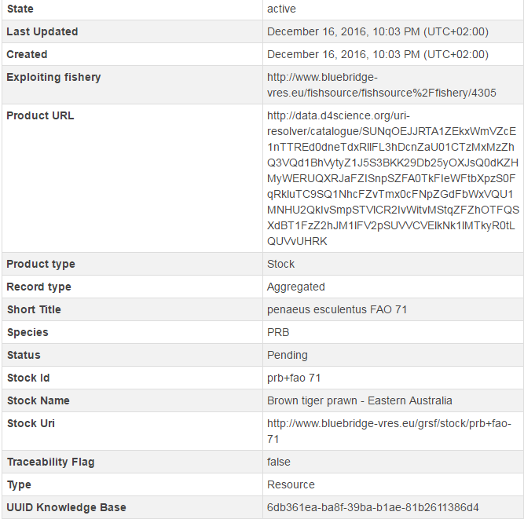
GRSF as a product GRSF Catalogue – cont’d

Slide 34
Next Steps
There is much heterogeneity with the usage of standards between the sources that prevents the merging of the majority of records.
FIRMS
Species standard: 3alpha code (or scientific name)
Area standard: iccat_smu (and others)
RAM
Species standard: scientific name
Area standard: their own naming & included FAO code from mapping
FIRMS record : YFT + YFT_ATL
RAM record : Thunnus albacares + multinational-ICCAT-ATL;27;21;41;47;31;34
Solution 1 (and plan for the next period): agreement on standards between the sources and harmonization of their data
Solution 2: Transformation of the sources records to align with specific standards.
Solution 3: Creation of same-as relationships using the experts.

Slide 35
Next Steps – cont’d
Fully integrate grsf-services-core components with MatWare
Implement a front-end for MatWare
Support update functionalities for published records (both in the GRSF KB and the GRSF Catalog)
Include VOID descriptions (provenance extensions) to keep the provenance of information in the Knowledge Base (http://www.ics.forth.gr/isl/VoIDWarehouse/VoID_Extension_Schema.owl)

Slide 36
References
GRSF Wiki pages
https://support.d4science.org/projects/stocksandfisherieskb/wiki/GRSF
https://support.d4science.org/projects/stocksandfisherieskb/wiki/GRSF_KB
https://support.d4science.org/projects/stocksandfisherieskb/wiki/GRSF_KB_modeling
https://support.d4science.org/projects/stocksandfisherieskb/wiki/GRSF_database_overview

Slide 37
References
MarineTLO
http://wiki.i-marine.eu/index.php/Top_Level_Ontology
http://wiki.i-marine.eu/index.php/MarineTLO-based_warehouse
http://www.ics.forth.gr/isl/MarineTLO/
MarineTLO-based warehouse
https://i-marine.d4science.org/
Connectivity Metrics & VoID extension: A set of metrics to assess the connectivity of sources and the quality of the constructed Knowledge Base
http://www.ics.forth.gr/isl/MatWare/files/tzitzik2014_connectivity_LWDM.pdf
http://www.ics.forth.gr/isl/VoIDWarehouse
CIDOC and CRM Family models
http://www.cidoc-crm.org/
http://www.ics.forth.gr/isl/CRMext

Slide 38
References
MatWare: Automates the construction and evaluation of the connectivity of a semantic warehouse
http://www.ics.forth.gr/isl/MatWare/
https://redmine-d.d4science.org/projects/gcube/repository/show/application/MatwarePlugins
X3ML Engine: Handles the URI generation and the data transformation steps of the data provision and aggregation process
https://github.com/delving/x3ml
GRSF-services-core: publishes the GRSF KB contents in the GRSF VRE catalogue
https://wiki.gcube-system.org/index.php?title=GRSF-services#grsf-services-core
https://redmine-d.d4science.org/projects/gcube/repository/show/application/GRSF/grsf-services-core
GRSF-services-updater: updates the status of a GRSF record in the GRSF KB and publishes approved GRSF records in the public GRSF VRE
https://wiki.gcube-system.org/index.php?title=GRSF-services#grsf-services-updater
https://redmine-d.d4science.org/projects/gcube/repository/show/application/GRSF/grsf-services-updater

