Slide 1
Constructing and Exploiting GRSF
FORTH-ICS
BlueBRIDGE
December 6, 2016

Slide 2
Outline
Current Status
GRSF-services-core
GRSF-services-updater
Suggestions for modifications
On stocks
On Fisheries

Slide 3
Current Status
GRSF-services-core
The component which is responsible for publishing records from the GRSF KB → GRSF Data Catalogue
Status: Completed (1st version)
Published ~ 20 stocks and 41 fisheries
Open: Suggestions for modifications (see next slides)
Link: https://wiki.gcube-system.org/index.php?title=GRSF-services#grsf-services-core

Slide 4
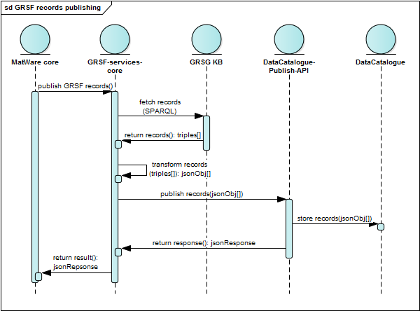
Current Status

Slide 5
Current Status
GRSF-services-updater
The component which is responsible for updating the status of records upon user feedback
Status: Completed (1st version)
Link: https://wiki.gcube-system.org/index.php?title=GRSF-services#grsf-services-updater

Slide 6
Current Status
GRSF-services-updater
Input
Output

Slide 7
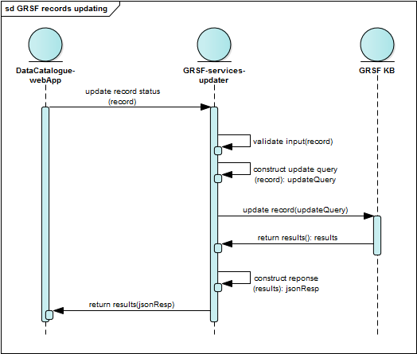
Current Status

Slide 8
Suggestion for modification On Stocks
Species
Currently each stock contains only one species, however there might be stocks containing more than one species
Field → Field[]
RefersTo
This property is missing from the data catalogue. It is pointer referring to the original records (from FIRMS, RAM, FishSource)
Add it as a Field[]

Slide 9
Suggestion for modification On Stocks
Exploiting Fisheries
There are more than one fisheries for a given stock
Field → Field[]
Assessment distribution area
Contains multiple values. It is also mandatory in the GRSF Data Catalogue.
Field → Field[]

Slide 10
Standard Exploitation Rate
Use pairs of terms from a controlled vocabulary and the year i.e.
High fishing mortality
Moderate fishing mortality

Slide 11
Suggestion for modification On Stocks
Exploitation Rate
For use with free text values. i.e.
F2010-2012/F0.1: Low potential recruitment = 0.60 (0.50-0.72)
F2011/FMSY = 1.04 range (0.38-1.32)
F2013/FMSY = Likely<1
Fcur/FMSY = 0.72 range (0.55-0.89)
Add it as a JSON Array of objects {“unit”: “…”, “value”: “…”, “year” : “…”}

Slide 12
Suggestion for modification On Stocks
Standard Abundance Level
Use pairs of terms from a controlled vocabulary and the year i.e.
Intermediate abundance
Intermediate abundance, Close to overfished

Slide 13
Suggestion for modification On Stocks
Abundance Level
For use with free text values. i.e.
SSB2013/SSBFMSY: Low potential recruitment =2.25 (1.92-2.68) / High potemtial recruitment =0.48 (0.35-0.72)
B2012/BMSY = 0.92 range (0.71-1.26)
B2013/BMSY = Likely>1
Add it as an array of JSON objects {“unit”: “…”, “value”: “…”, “year” : “…”}

Slide 14
Suggestion for modification On Stocks
Exploitation Rate Grouping
Value ? Who updates this value?
Teclo Dec 1, decision: Better remove it
Abundance Level Grouping
Value ? Who updates this value?
Teclo Dec 1, decision: Better remove it
SourceOfInformation
Empty in some cases (i.e. FishSource)
Make it optional (currently it is mandatory)

Slide 15
Suggestion for modification On Fisheries
Reporting Year
It is missing from the GRSF Data Catalogue
Add it as a Field
RefersTo
This property is missing from the data catalogue. It is pointer referring to the original records (from FIRMS, RAM, FishSource)
Add it as a Field[]

Slide 16
Suggestion for modification On Fisheries
FishingAreas
Contains multiple values
Field → Field[]
JurisdictionAreas
Contains multiple values
Field → Field[]
SourceOfInformation
Empty in some cases (i.e. FishSource)
Make it optional (currently it is mandatory)

Slide 17
Suggestion for modification On Fisheries
Stocks
Some of them contains multiple values .
Field → Field[]

