Slide 1
GRSF Progress Report
FORTH-ICS
minadakn@ics.forth.gr
marketak@ics.forth.gr
BlueBRIDGE
September 12, 2016

Slide 2
Outline
FORTH’s activities June – September 2016
Testing Queries Presentation
Competency Queries Presentation
Next Steps

Slide 3
FORTHs Activities
Updated Requirements
Requirements Analysis
Refinement of Modelling
Refinement of Mappings
Extensions of Matware
Collection of Issues
Transformation of Data
Importing of Data
CQs Formulation
Testing

Slide 4
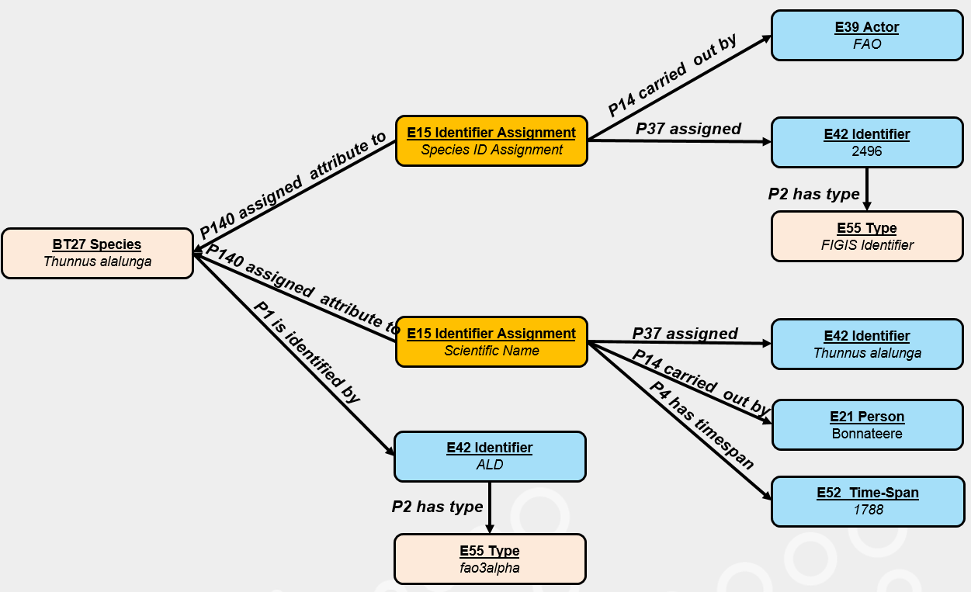
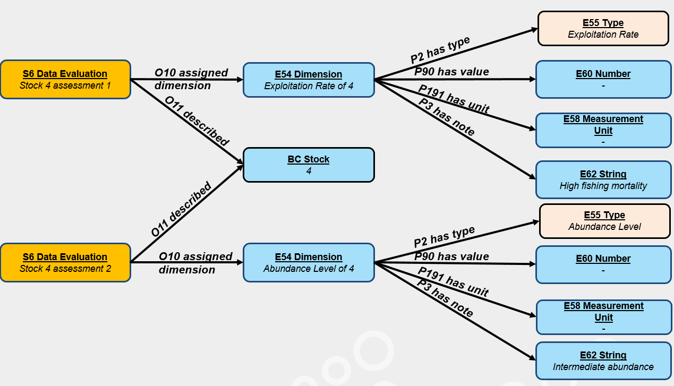
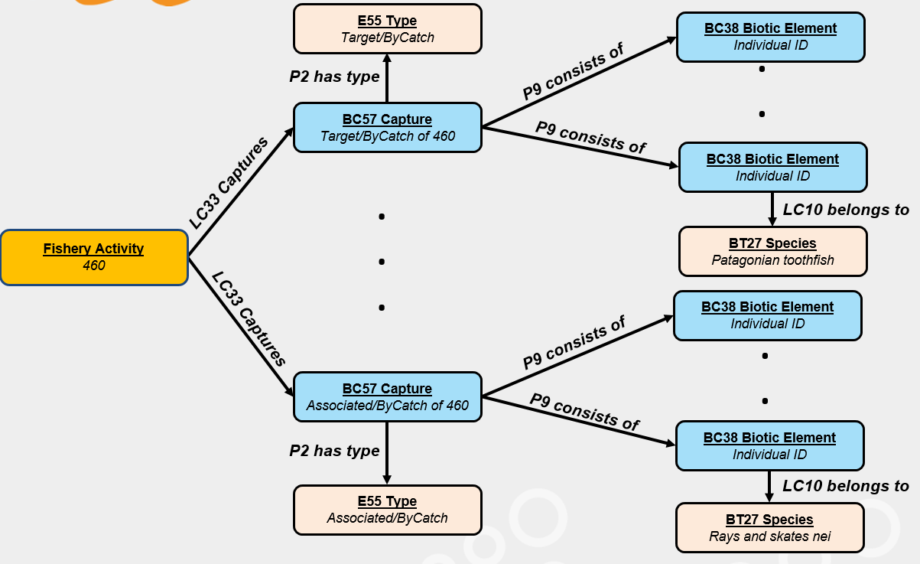
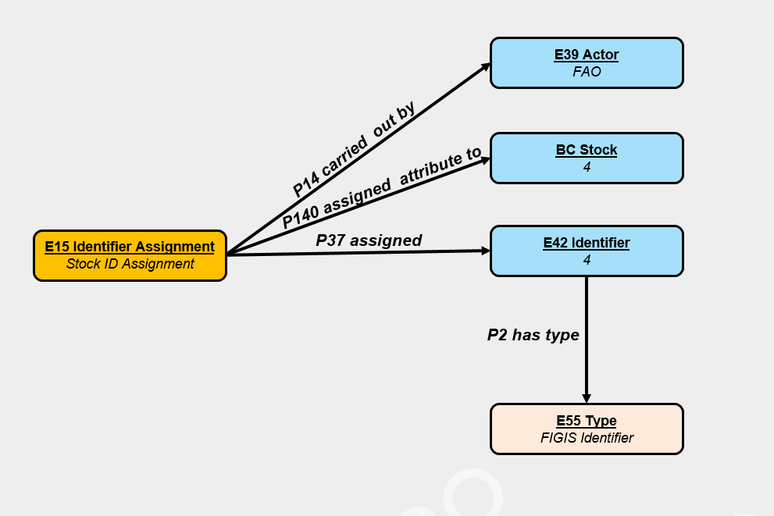
Refinement of Modelling

Slide 5
Refinement/Extensions of Mappings
x3ml mapping files
  FIRMS
  RAM
URI Generators
  27 new generators
  Reduced to 7
Improvement of execution times
  Shortcuts
x3ml Engine Code Extensions/Modifications
3M editor interface improvements
  http://139.91.183.3/3M
Notes:
GRSF-telco-2016-09-12 comments:
CNR mentioned that 3M requires authentication, so if we want to integrate it in the infrastructure (and we should) then we should get rid of its own authentication – In turn the infrastructure will take care of authentication activities.

Slide 6
Transformation and Importing of Data
FIRMS Stocks
  stock_1_en
  stock_2_en
  stock_4_en
  stock_5_en
  stock_7_en
  stock_9_en
  stock_10_en
  stock_6010_en
  stock_10210_en
  stock_10311_en
  stock_10318_en
  stock_10319_en
  stock_10320_en
  stock_10324_en
  stock_10511_en
  stock_13573_en
FIRMS Fisheries
  fishery_345_en
  fishery_346_en
  fishery_348_en
  fishery_355_en
  fishery_360_en
  fishery_472_en
  fishery_573_en
  fishery_662_en
  fishery_677_en
  fishery_760_en
  stock_970_en
RAM
  Full RAM Database
Data Imported to Virtuoso Triple Store / May migrate to Blazegraph

Slide 7
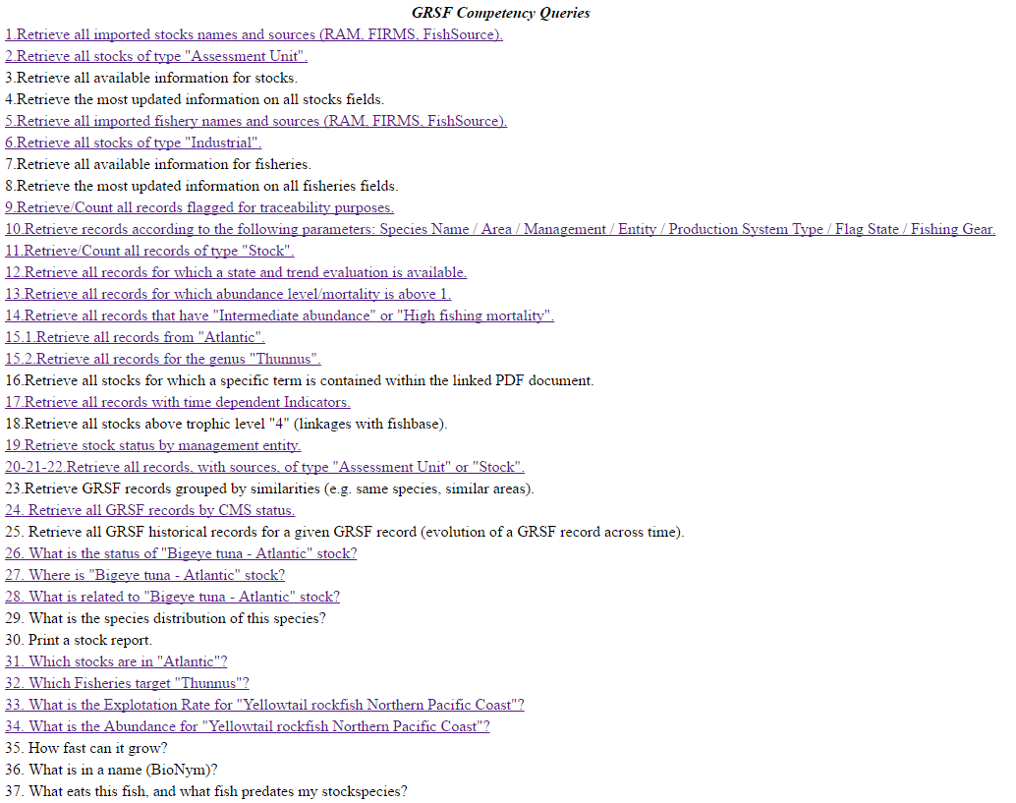
Formulation of Queries
23 Competency Queries
21 Stock Queries
17 Fisheries Queries
Can be tested at:
http://62.217.127.124/grsf/

Slide 8
Requirements – Stocks (Resources)
Concept (Stocks)
Stock Name
Stock ID
Scientific Name
Area
Exploiting fishery
Management Entity
Catches or Landings
Assessment Method
State of Marine Resources
Exploitation Rate
Abundance Level
Narrative State and Trend
Scientific Advice
Database Sources
Concept (Stocks)
Source of Information
Data Owner
Type
Reporting Entity
Reporting Year
UUID for source record
Semantic ID
Semantic Label
UUID for GRSF record
Document
Status (Pending/Confirmed)

Slide 9
Stock Name
StockName
Skipjack tuna - Eastern Pacific
Albacore - South Atlantic
Bigeye tuna - Indian Ocean
Capelin - Southern Grand Bank
Mackerel icefish - South Georgia
Southern Bluefin tuna - Global
Cape hakes - South Africa Eastern
Bigeye tuna - Atlantic
American Plaice - Flemish Cap
Greenland halibut - Labrador Shelf, Northeast Newfoundland Shelf, Northern Grand Bank
Redfish - Flemish Cap
Atlantic Cod - Flemish Cap
Lesser African threadfin - Guinea
Albacore - Northern Pacific
Albacore - Indian Ocean
Albacore - North Atlantic

Slide 10
Stock ID
Stock | StockID
Skipjack tuna - Eastern Pacific | SKJ - EPO
Albacore - South Atlantic | ALB - ALB_S
Bigeye tuna - Indian Ocean | BET - IOTC
Capelin - Southern Grand Bank | CAP - 21.3.N
Mackerel icefish - South Georgia | ANI - 48.3
Southern Bluefin tuna - Global | SBF - 41.2.4
Cape hakes - South Africa Eastern | HKK - 51.8
Bigeye tuna - Atlantic | BET - BET_ATL
American Plaice - Flemish Cap | PLA - 21.3.M
Greenland halibut - Labrador Shelf, Northeast Newfoundland Shelf, Northern Grand Bank | GHL - 21.2
Redfish - Flemish Cap | RED - 21.3.M
Atlantic Cod - Flemish Cap | COD - 21.3.M
Lesser African threadfin - Guinea | GAL - 34.3.13
Albacore - Northern Pacific | ALB - NPO
Albacore - Indian Ocean | ALB - IOTC
Albacore - North Atlantic | ALB - ALB_N
ToDo : refine mapping file to include all areas
Notes:
GRSF-telco-2016-09-12 comments:
FAO mentioned that some stocks seem to have only one area. FORTH responded that the inclusion of more areas is an ongoing activity.

Slide 11
Stock DataBase Source
Stock | Source
Skipjack tuna - Eastern Pacific | FIRMS
Albacore - South Atlantic | FIRMS
Bigeye tuna - Indian Ocean | FIRMS
Capelin - Southern Grand Bank | FIRMS
Mackerel icefish - South Georgia | FIRMS
Southern Bluefin tuna - Global | FIRMS
Cape hakes - South Africa Eastern | FIRMS
Bigeye tuna - Atlantic | FIRMS
American Plaice - Flemish Cap | FIRMS
Greenland halibut - Labrador Shelf, Northeast Newfoundland Shelf, Northern Grand Bank | FIRMS
Redfish - Flemish Cap | FIRMS
Atlantic Cod - Flemish Cap | FIRMS
Albacore - Northern Pacific | FIRMS
Albacore - Indian Ocean | FIRMS
Albacore - North Atlantic | FIRMS

Slide 12
Stock Status
Stock | Status
Skipjack tuna - Eastern Pacific | pending
Albacore - South Atlantic | pending
Bigeye tuna - Indian Ocean | pending
Capelin - Southern Grand Bank | pending
Mackerel icefish - South Georgia | pending
Southern Bluefin tuna - Global | pending
Cape hakes - South Africa Eastern | pending
Bigeye tuna - Atlantic | pending
American Plaice - Flemish Cap | pending
Greenland halibut - Labrador Shelf, Northeast Newfoundland Shelf, Northern Grand Bank | pending
Redfish - Flemish Cap | pending
Atlantic Cod - Flemish Cap | pending
Albacore - Northern Pacific | pending
Albacore - Indian Ocean | pending
Albacore - North Atlantic | pending
ToDo : semantically define “pending/confirmed”

Slide 13
Species Information
Stock | CommonName | ScientificName | 3AlphaCode
Bigeye tuna - Indian Ocean | Bigeye tuna | Thunnus obesus | BET
Bigeye tuna - Atlantic | Bigeye tuna | Thunnus obesus | BET
Southern Bluefin tuna - Global | Southern bluefin tuna | Thunnus maccoyii | SBF
Lesser African threadfin - Guinea | Lesser African threadfin | Galeoides decadactylus | GAL
Albacore - South Atlantic | Albacore | Thunnus alalunga | ALB
Albacore - Northern Pacific | Albacore | Thunnus alalunga | ALB
Albacore - Indian Ocean | Albacore | Thunnus alalunga | ALB
Albacore - North Atlantic | Albacore | Thunnus alalunga | ALB
Skipjack tuna - Eastern Pacific | Skipjack tuna | Katsuwonus pelamis | SKJ
American Plaice - Flemish Cap | Amer. plaice(=Long rough dab) | Hippoglossoides platessoides | PLA
Capelin - Southern Grand Bank | Capelin | Mallotus villosus | CAP
Atlantic Cod - Flemish Cap | Atlantic cod | Gadus morhua | COD
Mackerel icefish - South Georgia | Mackerel icefish | Champsocephalus gunnari | ANI

Slide 14
Area Code
StockName | Area | AreaType
Skipjack tuna - Eastern Pacific | East Pacific Ocean | pac_tuna_rep
Albacore - South Atlantic | South Atlantic | iccat_smu
Bigeye tuna - Indian Ocean | IOTC area of competence | rfb_comp
Capelin - Southern Grand Bank | Atlantic, Northwest / 21.3.O | fao_div
Capelin - Southern Grand Bank | Atlantic, Northwest / 21.3.N | fao_div
Mackerel icefish - South Georgia | Atlantic Antarctic / 48.3 | fao_sub_area
Southern Bluefin tuna - Global | SEAFO division D.0 | fao_div
Southern Bluefin tuna - Global | Cape of Good Hope | fao_div
Southern Bluefin tuna - Global | SEAFO division C.0 | fao_div
Southern Bluefin tuna - Global | Indian Ocean, West / 51.7 | fao_sub_area
Southern Bluefin tuna - Global | SEAFO division B.1 | fao_div
Southern Bluefin tuna - Global | Indian Ocean, West / 51.6 | fao_sub_area
Southern Bluefin tuna - Global | SEAFO division B.0 | fao_div

Slide 15
Indicators
Stock | Indicator | Value
Skipjack tuna - Eastern Pacific | Exploitation Rate | Moderate fishing mortality
Skipjack tuna - Eastern Pacific | Abundance Level | Intermediate abundance
Albacore - South Atlantic | Abundance Level | Intermediate abundance
Albacore - South Atlantic | Exploitation Rate | High fishing mortality
Bigeye tuna - Indian Ocean | Abundance Level | Intermediate abundance
Bigeye tuna - Indian Ocean | Exploitation Rate | High fishing mortality
Capelin - Southern Grand Bank | Exploitation Rate | No or low fishing mortality
Capelin - Southern Grand Bank | Abundance Level | Uncertain/Not assessed
Southern Bluefin tuna - Global | Exploitation Rate | Moderate fishing mortality
Southern Bluefin tuna - Global | Abundance Level | Low abundance
Cape hakes - South Africa Eastern | Exploitation Rate | Moderate fishing mortality
Cape hakes - South Africa Eastern | Exploitation Rate | High fishing mortality
Cape hakes - South Africa Eastern | Abundance Level | Low abundance

Slide 16
Narrative State and Trend
Stock | NarrativeState
Bigeye tuna - Indian Ocean | Stock size and fishing pressure are considered to be close to their value at MSY.
Southern Bluefin tuna - Global | <p>The 2014 assessment suggested that the SBT spawning biomass is at a very low fraction (9%) of its original biomass as well as below the level that could produce maximum sustainable yield. However, there has been some improvement since the 2011 stock assessment and the fishing mortality rate is below the level associated with MSY. &nbsp;The current TAC has been set using the management procedure adopted in 2011, which has a 70% probability of rebuilding to the interim target biomass level by 2035.</p>
Lesser African threadfin - Guinea | Fully exploited in Guinea and Sierra Leone; over exploited in C&#244;te d'Ivoire, Ghana, Togo, Benin, Cameroon, Equatorial Guinea, Gabon, Angola.
Albacore - Indian Ocean | Stock size and fishing pressure are considered to be within acceptable limits. Catches, mean weight and catch rates of albacore have been stable for over 20 years.
Notes:
GRSF-telco-2016-09-12 comments:
FORTH mentioned that they will work on cleaning text segments from html special characters (i.e. &nbsp;, <p>, etc.)

Slide 17
Related Fisheries
Stock | Fishery
Skipjack tuna - Eastern Pacific | Tunas and billfishes fishery
Albacore - Northern Pacific | Tunas and billfishes fishery
Mackerel icefish - South Georgia | Icefish fishery - South Georgia (Subarea 48.3)

Slide 18
Assessment Method
Stock | Assessment Method
Skipjack tuna - Eastern Pacific | Fisheries Indicators
Capelin - Southern Grand Bank | Analytical assessment
American Plaice - Flemish Cap | Analytical assessment
Greenland halibut - Labrador Shelf, Northeast Newfoundland Shelf, Northern Grand Bank | Analytical assessment
Redfish - Flemish Cap | Analytical assessment
Atlantic Cod - Flemish Cap | Analytical assessment
Mackerel icefish - South Georgia | Short-term assessment
Cape hakes - South Africa Eastern | Survey index

Slide 19
Scientific Advice
Stock | Scientific Advice
Bigeye tuna - Indian Ocean | The indices of abundance from two longline fleets available for this stock present divergent trends over the last few years, the differences observed in targeting are not fully explained.
Southern Bluefin tuna - Global | <p>Based on the results of the MP operation for 2015&ndash;17 in its 2013 meeting and the outcome of the review of exceptional circumstances in its 2015 meeting, the ESC recommended that there is no need to revise the Extended Commission&rsquo;s 2013 TAC decision regarding the TAC for 2016&ndash;17. The recommended annual TAC for the years 2016-2017 is 14,647.4t.</p>
Albacore - Indian Ocean | Based on the preliminary analyses undertaken in 2008 there are no indications that that the albacore stock is overfished (B2007/BMSY &gt;1) and overfishing is currently likely not occurring for the scenarios envisaged. Point estimates of MSY ranged from 28,260 t to 34,415 t. This indicated, that continuous annual catches at a level approaching 38,000 t (equivalent to the historically high level of catch experienced over the period 1998 to 2001) may not be sustainable in the long term.
ToDo : semantically define
ToDo : handle BCDATA/tags
Notes:
GRSF-telco-2016-09-12 comments:
FORTH mentioned that they will work on cleaning text segments from html special characters (i.e. &nbsp;, <p>, etc.)

Slide 20
Source of Information
Stock | Publication | PublicationTitle | Publisher
Skipjack tuna - Eastern Pacific | http://www.iattc.org/PDFFiles2/FisheryStatusReports/FisheryStatusReport13.pdf | "Tunas and billfishes in the eastern Pacific Ocean in 2014. Inter-American Tropical Tuna Commission." Fishery Status Report. IATTC 2015.
Albacore - Indian Ocean | http://www.iotc.org/files/proceedings/2009/sc/IOTC-2009-SC-R%5BE%5D.pdf | Report of the Twelfth Session of the Scientific Committee of the IOTC. IOTC-2009-SC-R[E]
Albacore - South Atlantic | http://www.iccat.int/Documents/BienRep/REP_EN_12-13_II_2.pdf | Albacore, Executive Summary. | ICCAT
Albacore - North Atlantic | http://www.iccat.int/Documents/BienRep/REP_EN_12-13_II_2.pdf | Albacore, Executive Summary. | ICCAT

Slide 21
Document
Document | Owner | Stock
IATTC Stock Status Reports | IATTC | Skipjack tuna - Eastern Pacific
ICCAT SCRS Reports | SCRS | Albacore - South Atlantic
ICCAT SCRS Reports | ICCAT | Albacore - South Atlantic
IOTC Stock Status Reports | IOTC | Bigeye tuna - Indian Ocean
NAFO Summary Sheets | NAFO | Capelin - Southern Grand Bank
CCAMLR Fisheries Reports | CCAMLR | Mackerel icefish - South Georgia
CCSBT Stock Status Reports | CCSBT | Southern Bluefin tuna - Global
SWIOFC Stock Status Reports | FAO | Cape hakes - South Africa Eastern
ICCAT SCRS Reports | SCRS | Bigeye tuna - Atlantic
ICCAT SCRS Reports | ICCAT | Bigeye tuna - Atlantic
NAFO Summary Sheets | NAFO | American Plaice - Flemish Cap
NAFO Summary Sheets | NAFO | Greenland halibut - Labrador Shelf, Northeast Newfoundland Shelf, Northern Grand Bank
NAFO Summary Sheets | NAFO | Redfish - Flemish Cap
NAFO Summary Sheets | NAFO | Atlantic Cod - Flemish Cap
Notes:
GRSF-telco-2016-09-12 comments:
FAO mentioned that in some cases there can be more than documents. These documents are actually the fact sheets.

Slide 22
Reporting Year
Stock | Year
Lesser African threadfin - Guinea | 2005
Greenland halibut - Labrador Shelf, Northeast Newfoundland Shelf, Northern Grand Bank | 2011
Cape hakes - South Africa Eastern | 2010
Bigeye tuna - Indian Ocean | 2009
Albacore - Indian Ocean | 2009
American Plaice - Flemish Cap | 2014
Mackerel icefish - South Georgia | 2012
Albacore - South Atlantic | 2013
Albacore - North Atlantic | 2013
Skipjack tuna - Eastern Pacific | 2015
Capelin - Southern Grand Bank | 2015
Southern Bluefin tuna - Global | 2015
Bigeye tuna - Atlantic | 2015
Redfish - Flemish Cap | 2015
Atlantic Cod - Flemish Cap | 2015
Albacore - Northern Pacific | 2015

Slide 23
Also…
Management Entity
  Not in Stocks
Catches or Landings
  Not in Stocks
Type:
  Is there a specific field in FIRMS?
  We were using “biologicalStock:yesOrNo”
  Is everything a resource?
Reporting Entity
  Not in FIRMS
Notes:
GRSF-telco-2016-09-12 comments:
FORTH asked if management entities do exist for stocks in FIRMS. FAO confirmed that they do not exist.
FORTH asked if catch or landings do exist for stocks in FIRMS. FAO confirmed that they do not exist.
FORTH question about type: FAO responded that if there is an indication about trend or state then it is an Assessment Unit, otherwise it is a resource.
FORTH question about reporting entity. FAO answered that there is nothing in FIRMS (such information comes from RAM)

Slide 24
Requirements – Fisheries (Resources)
Concept (Fisheries)
Fishery Name
Fishery ID
Scientific Name
Area
Exploiting Stocks
Management Entity
Jurisdiction Area
Production System Type
Flag State
Fishing Gear
Catches or Landings
Database Sources
Concept (Fisheries)
Source of Information
Data Owner
Type
Environment
UUID for source record
Semantic ID
Semantic Label
UUID for GRSF record
Document
Status (Pending/Confirmed)
Traceability Flag

Slide 25
Fishery Name
FisheryName
Shark Fisheries
Fisheries sector
Bottom trawl black hake fishery - Senegalese waters
Jelly fishes fishery - Bahraini gulf waters (up to 10 m)
NAFO Flemish Cap groundfish fisheries
Tunas and billfishes fishery
Icefish fishery - South Georgia (Subarea 48.3)
Toothfish fishery - Eastern Ross Sea (Subarea 88.1)
NAFO fisheries
Lobster fishery
Danish fishing fleet
ToDo : add multiple values

Slide 26
Fishery ID (Traceability Check)
Fishery | identifier_label
NAFO Flemish Cap groundfish fisheries | COD - 21.3.M - NAFO - OTB - CAN - Industrial
ToDo : add multiple values

Slide 27
Catches and Landings
Fishery | Indicator | Value | Unit | Year
NAFO Flemish Cap groundfish fisheries | Catch | 18692 | ton | 2014

Slide 28
Management Entity and Jurisdiction
Fishery | ManagementEntity | JurisdictionArea
Bottom trawl black hake fishery - Senegalese waters | European Union | Senegal
Bottom trawl black hake fishery - Senegalese waters | Ministère de l’Economie Maritime des Transports Maritimes de la Pêche et de la Pisciculture | Senegal
Jelly fishes fishery - Bahraini gulf waters (up to 10 m) | Public Commission for The Protection of Marine Resources, Environment and Wild Life. General Directorate for the Protection of Marine | Bahrain
Tunas and billfishes fishery | Inter-American Tropical Tuna Commission (IATTC) | IATTC area of competence
NAFO Flemish Cap groundfish fisheries | Northwest Atlantic Fisheries Organization (NAFO) | NAFO area of competence
NAFO fisheries | Northwest Atlantic Fisheries Organization (NAFO) | NAFO area of competence

Slide 29
Related Stock
Fishery | Stock
Bottom trawl black hake fishery - Senegalese waters | Senegal hake, Benguela hake - Mauritania, Senegal and Gambia
Bottom trawl black hake fishery - Senegalese waters | West African geryon - Morocco, Mauritania, Senegal and Gambia
Tunas and billfishes fishery | Skipjack tuna - Eastern Pacific
Tunas and billfishes fishery | Bigeye tuna - Eastern Pacific (EPO)
Tunas and billfishes fishery | Yellowfin tuna - Eastern Pacific
Tunas and billfishes fishery | Albacore - Northern Pacific
Toothfish fishery - Eastern Ross Sea (Subarea 88.1) | Toothfish - Eastern Ross Sea
NAFO fisheries | Capelin - Southern Grand Bank
NAFO fisheries | Atlantic Cod - Grand Bank
NAFO fisheries | American Plaice - Grand Bank
NAFO fisheries | Witch flounder - Northeast Newfoundland Shelf and Northern Grand Bank
NAFO fisheries | Squid - Scotian Shelf, Grand Bank

Slide 30
Production System Type
Fishery | ProductionSystemType
Bottom trawl black hake fishery - Senegalese waters | Industrial
Bottom trawl black hake fishery - Senegalese waters | Commercial
Jelly fishes fishery - Bahraini gulf waters (up to 10 m) | Artisanal
NAFO Flemish Cap groundfish fisheries | Industrial
Toothfish fishery - Eastern Ross Sea (Subarea 88.1) | Exploratory_fishery
Lobster fishery | Commercial

Slide 31
Flag State
Fishery | Country | ISO3Code
Bottom trawl black hake fishery - Senegalese waters | Spain | ESP
NAFO Flemish Cap groundfish fisheries | Spain | ESP
NAFO Flemish Cap groundfish fisheries | Russian Federation | RUS
NAFO Flemish Cap groundfish fisheries | Lithuania | LTU
NAFO Flemish Cap groundfish fisheries | Canada | CAN
NAFO Flemish Cap groundfish fisheries | Estonia | EST
NAFO Flemish Cap groundfish fisheries | Portugal | PRT
NAFO Flemish Cap groundfish fisheries | Norway | NOR
Jelly fishes fishery - Bahraini gulf waters (up to 10 m) | Bahrain | BHR
Shark Fisheries | Thailand | THA
Lobster fishery | Bahamas | BHS
Shark Fisheries | Cambodia | KHM

Slide 32
Gear Type
Fishery | GearType | Acronym
Shark Fisheries | Push nets | PUN
Shark Fisheries | Gillnets (not specified) | GN
Shark Fisheries | Otter trawls (not specified) | OT
Shark Fisheries | Purse seines | PS
Shark Fisheries | Hooks and lines | LL
Jelly fishes fishery - Bahraini gulf waters (up to 10 m) | Hooks and lines | LL
Shark Fisheries | Pair trawls (not specified) | PT
Bottom trawl black hake fishery - Senegalese waters | Bottom otter trawls | OTB
NAFO Flemish Cap groundfish fisheries | Bottom otter trawls | OTB
Lobster fishery | Miscellaneous gear | MIS

Slide 33
Also…
Type:
  What exactly to include and which is the corresponding FIRMS field?
Environment
  Need to integrate with Fishbase
Notes:
GRSF-telco-2016-09-12 comments:
FORTH asked what exactly to use as the type of a fishery. FAO responded that a fishery can be either a Fishing Activity or a Fishing Description. When at least the fileds species, gear, flag state, management entity are available it is a Fishing activity, otherwise it is a Fishing description. (This is also documented in the requirements wiki page https://support.d4science.org/projects/stocksandfisherieskb/wiki/GRSF_database_overview#Fishery)

Slide 34
RAM – Source/Status/Type
Stock | Source | Status | Type
Sardine Northern Adriatic Sea | RAM | pending | Assessment Unit
Atlantic Halibut NAFO-5YZ | RAM | pending | Assessment Unit
False Scad West Africa | RAM | pending | Assessment Unit
Canary rockfish Pacific Coast | RAM | pending | Assessment Unit
Yellowfin sole Bering Sea and Aleutian Islands | RAM | pending | Assessment Unit
Vermilion snapper Southern Atlantic coast | RAM | pending | Assessment Unit
Ocean quahog Atlantic Coast | RAM | pending | Assessment Unit
Arrowtooth flounder Pacific Coast | RAM | pending | Assessment Unit
Sardine West Africa Zone C | RAM | pending | Assessment Unit
Acadian redfish NAFO-2J3K | RAM | pending | Assessment Unit

Slide 35
RAM – SemanticID
Stock | StockID
Sardine Northern Adriatic Sea | Sardina pilchardus - multinational-GFCM-GSA17
Atlantic Halibut NAFO-5YZ | Hippoglossus hippoglossus - USA-NMFS-5YZ
False Scad West Africa | Caranx rhonchus - multinational-FAO-WA
Yellowfin sole Bering Sea and Aleutian Islands | Limanda aspera - USA-NMFS-BSAI
Vermilion snapper Southern Atlantic coast | Rhomboplites aurorubens - USA-NMFS-SATLC
Ocean quahog Atlantic Coast | Arctica islandica - USA-NMFS-ATLC
Sardine West Africa Zone C | Sardina pilchardus - multinational-FAO-Z-C
Pollock ICES IIIa, VI and North Sea | Pollachius virens - multinational-ICES-IIIa-IV-VI
Acadian redfish NAFO-2J3K | Sebastes fasciatus - Canada-DFO-2J3K
Sockeye Salmon Pauls Bay Drainage | Oncorhynchus nerka - USA-AKSTATE-PAULSBD
common European sole Western English Channel | Solea vulgaris - multinational-ICES-VIIe
Pink Salmon Pybus/Ga (District110) | Oncorhynchus gorbuscha - USA-AKSTATE-PYBUSGA
Sockeye Salmon Saltery Lake | Oncorhynchus nerka - USA-AKSTATE-SALTERYL
Chum Salmon Chignik Eastern District | Oncorhynchus keta - USA-AKSTATE-CHIGED
Yellowtail rockfish Northern Pacific Coast | Sebastes flavidus - USA-NMFS-NPCOAST

Slide 36
RAM Assessment
Stock | Assessment | AssessMethod | ReportingDate | Document | Assessor
Sardine Northern Adriatic Sea | GRP3-SARDMEDGSA17-1999-2011-BANOBI | ICA | Fri May 16 00:00:00 EEST 2014 | 2012_PIL_GSA17_CNR-ISMAR_IZOR_ZZRS_ADRIAMED.pdf | GRP3
False Scad West Africa | FAO-SPNWA-FSCADWA-1990-2010-CHING | Unknown | Tue Oct 22 00:00:00 EEST 2013 | FAO West African Pelagics North 2011.pdf | FAO-SPNWA
Sardine West Africa Zone C | FAO-SPNWA-SARDWAZC-1990-2010-CHING | DPM | Tue Oct 22 00:00:00 EEST 2013 | FAO West African Pelagics North 2011.pdf | FAO-SPNWA
Sardinella West Africa | FAO-SPNWA-SARDINWA-1990-2010-CHING | DPM | Tue Oct 22 00:00:00 EEST 2013 | FAO West African Pelagics North 2011.pdf | FAO-SPNWA
Round Sardinella West Africa | FAO-SPNWA-RSARDINWA-1990-2010-CHING | DPM | Tue Oct 22 00:00:00 EEST 2013 | FAO West African Pelagics North 2011.pdf | FAO-SPNWA

Slide 37
RAM Assessor / Management Entity
AssessorAcronym | AssessorName | ManagementEntity
DFO | Department of Fisheries and Oceans, Canada national management | DFO
DFO | Department of Fisheries and Oceans | DFO
DFO-NFLD | Department of Fisheries and Oceans - Newfoundland Region | DFO
DFO-ARCTIC | Department of Fisheries and Oceans - Arctic Region | DFO
DFO-PAC | Department of Fisheries and Oceans - Pacific Region | DFO
DFO-QUE | Department of Fisheries and Oceans - Quebec Region | DFO
DFO-MAR | Department of Fisheries and Oceans - Maritimes Region | DFO
DFO-SG | Department of Fisheries and Oceans - Southern Gulf Region | DFO

Slide 38
RAM Abundance Rate
Assessment | Indicator | Value | Unit | Timespan
NEFSC-ATHAL5YZ-1800-2007-COL | Abundance | 49000.0 | tones | 1800-2007
AFSC-YSOLEBSAI-1949-2010-STACHURA | Abundance | 1252372.17305801 | tones | 1949-2010
SEFSC-VSNAPSATLC-1945-2012-HIVELY | Abundance | 2252.0 | tones | 1945-2012
FAO-SPNWA-SARDWAZC-1990-2010-CHING | Abundance | 3400129.412 | tones | 1990-2010

Slide 39
Competency Queries
Imported Records
Retrieve all imported stocks names and sources (RAM, FIRMS, FishSource).
2. Retrieve all imported stocks names and sources by Type (Type= assessment unit/
resource).
3. Retrieve all available information for all fields.
4. Retrieve the most updated information on all fields (the most recent)
5. Retrieve all imported fishery names and sources (RAM, FIRMS, FishSource).
6. Retrieve all imported fishery names and sources by Type (Type of approach= Fishery
Resource; Jurisdictional; Production System; Fishery Management Unit; Fishing Activity;
Access Rights).
7. Retrieve all available information for all fields.
8. Retrieve the most updated information on all fields (the most recent).
?
?
Can be tested at: http://62.217.127.124/grsf/
Notes:
GRSF-telco-2016-09-12 comments:
Competency Query 4, 8: FAO mentioned that it is the most up-to-date information that exists in the underlying source (i.e. there might be multiple information about catches during a time period and in that case we want to retrieve the latest one).

Slide 40
Competency Queries
GRSF Records
Traceability purpose
9. Retrieve/Count/DownloadExport all records flagged for traceability purposes
10. Retrieve records according to the following parameters: Species Name / Area / Management / Entity / Production System Type / Flag State / Fishing Gear
Analysis of stock status
11. Retrieve/Count/DownloadExport all records according to the type (assessment unit, resource…)
12. Retrieve all records for which a state and trend evaluation is available.
13. Retrieve all records for which abundance level/mortality is below/above a certain value.
14. Retrieve records according to a specific state and trend value (qualitative or quantitative) or
a combination of two (one specific level of abundance and one of exploitation rate)
15. Retrieve all records from a region (e.g. certain ocean) or by taxa/main groups.
16. Retrieve all stocks for which a specific term is contained within the linked PDF document
17. Retrieve time series of values (resulting from subsequent updates of the record) for any of the time dependent fields for a particular stock.
18. Retrieve all stocks above trophic level "4" (linkages with fishbase)
19. Retrieve stock status by management entity
?
?
Notes:
GRSF-telco-2016-09-12 comments:
Competency Query 16: FORTH mentioned that currently we are not exporting information from PDF document. FAO mentioned that is some kind of future requirement.
Competency Query 18: FORTH mentioned that this information exists in FishBase, so it will be captured most probably later (during the construction of the 2nd version of the GRSF KB)

Slide 41
Competency Queries
GRSF Records
Data management
20. Retrieve/Count/DownloadExport all GRSF stock records with names and sources
21. Retrieve all records with names and sources according to Type (assessment unit, resource…)
22. Retrieve all GRSF stock records with names and sources by Type
23. Retrieve GRSF records grouped by similarities (e.g. same species similar areas)
24. Retrieve all GRSF records by CMS status (rejected, pending, etc.)
25. Retrieve all GRSF historical records for a given GRSF record (evolution of a GRSF record across time)
?
?
Notes:
GRSF-telco-2016-09-12 comments:
Competency Query 23: FAO clarified that the similarities they are interested into exist between GRSF records in the final GRSF registry (not between the incoming records that exists in the GRSF KB).
Competency Query 25: FAO mentioned that there are no expectations for having historical records for the first version of the GRSF KB.

Slide 42
Competency Queries
User Oriented Queries
26. What is the status of 'this' stock?
27. Where is this stock?
28. What is related to this stock (capture records, fleet, operations, predation, stock Assessment)
29. What is the species distribution of this species?
30. Print a stock report
31. Which stocks in this EEZ / FAO area / Bounding box
32. For a particular species, which fisheries is it a target? Bycatch?
33. What is the MSY for this stock
34. What is the Biomass for this stock, and the historic one?
35. How fast can it grow?
36. What is in a name (BioNym)
37. What eats this fish, and what fish predates my stockspecies?
38. What is the LW relation?
39. Update an existing dataset with a new version of the entire dataset, with a future release data
40. Update an existing dataset with a new version of a part of the dataset, with a future release data
41. What is the reference metadataset for an entire dataset.
42. What is the reference metadataset for a datapoint?
43. Information system developers
44. Where is your api documented?
45. Where are your endpoints, and how are these documented
46. How can I add my own data?
?
?
?
Notes:
GRSF-telco-2016-09-12 comments:
Competency Query 30: A stock report is basically all the information that exist about a stock.
Competency Query 31: FORTH mentioned that as regards the Bounding Box, it is also needed to have a proper UI to search for. FAO mentioned that such data would be directly ingested in GRSF KB, in turn such information that exists in different components of the infrastructure could be linked with the corresponfing records of the GRSF. It is more like a future reference/query requirement. CNR mentioned that the adopted Data Catalog supports the functionality of searching within bounding boxes.

Slide 43
CQ1: Stock Names & Sources
StockName | Source
Skipjack tuna - Eastern Pacific | FIRMS
Albacore - South Atlantic | FIRMS
Bigeye tuna - Indian Ocean | FIRMS
Capelin - Southern Grand Bank | FIRMS
Mackerel icefish - South Georgia | FIRMS
Southern Bluefin tuna - Global | FIRMS
Cape hakes - South Africa Eastern | FIRMS
Bigeye tuna - Atlantic | FIRMS
Sardine Northern Adriatic Sea | RAM
Yellowfin sole Bering Sea and Aleutian Islands | RAM
Vermilion snapper Southern Atlantic coast | RAM
Ocean quahog Atlantic Coast | RAM

Slide 44
UUIDS
Components:
Species Name + Area + Management Entity + Pruduction System Type + Flag State + Fishing Gear
UUID Code
UUID Label
UUID short label
Minimum UUID for stocks: Species + Area
Minimum UUID for fishery: Area
Auto - generated UUID???
Notes:
GRSF-telco-2016-09-12 comments:
Auto-generated UUID: Should be created (automatically) from one of the involved components (FORTH, CNR). CNR mentioned that if it will be generated from the Data Catalogue it will be a UID, it won’t be a hash code of the semantic ID.

Slide 45
Main (post) importing workflow
Import Data From Sources
Matware Engine/Matware Webapp/x3ml Engine
Create UUID for each
Source Record
UUID services/x3ml Engine
Add Pending Labels
x3ml Engine
Create view of (merged) grsf records according to specs
grsf services core/x3ml Engine
Validate records
Data Calatogue/grsf services core
Create grsf records UUIDs
UUID services/x3ml Engine
Add traceability flags
grsf services core/x3ml Engine
Notes:
GRSF-telco-2016-09-12 comments:
CNR the last two steps that modify the records, so they have to update the information that exist in the data catalogue.
FAO mentioned that in some cases they do not need to just approve, or reject two records, they want to reject two records and declare that they should be merged with some others. FORTH mentioned that we have discussed previously about an annotation mechanism. FORTH to investigate what can be done with this (especially for rejected records). CNR mentioned that this feature should be implemented, however suggestions require technical solutions that are not currently available.

Slide 46
Short-term Plan (Until Pisa’s TCOM October 2016)
Refine FishSource mappings
Insert full data from FIRMS - FishSource
Matware Webapp 1st Version
Use CNR’s Catalogue Services
First Draft of UUIDs

Slide 47
Long-term issues to be solved
UUIDs assignment
User Interface Creation (???)
Finalization of Modelling/Mappings
Finalization of Manipulating Data Workflow
Solve multi - instantiation issues

Slide 48
Appendix
Design Slides
Workflow Slides
Previous Meetings Slides

Slide 49
The process
Web products
(map viewer, pie charts for regional stock status, etc.)
FIRMS
RAM
FishSource
GRSF KB
Web services
GRSF records
CMS

Slide 50




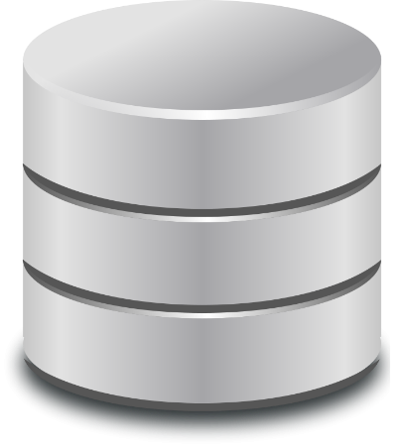







The Construction phase
GRSF
KB
X3ML eng

Slide 52
Constructing the GRSF KB
The knowledge base will be a set of triples <s,p,o>
Components required
  MatWare and plugins (under development)
    mappings, data fetching, transformations, ingestion, sameAs links
  MatWare front-end (to be developed)
    Assisting the user (VRE manager) to configure MatWare

Slide 53
Exploiting (and updating) GRSF KB
Requirements
  Inspect the set of records
    i.e. as tabular data (some mockups are given later)
  Support the competency queries
  Be able to approve/reject records
    Also attach a justification for (at least) rejected records
  Flag possible errors

Slide 54
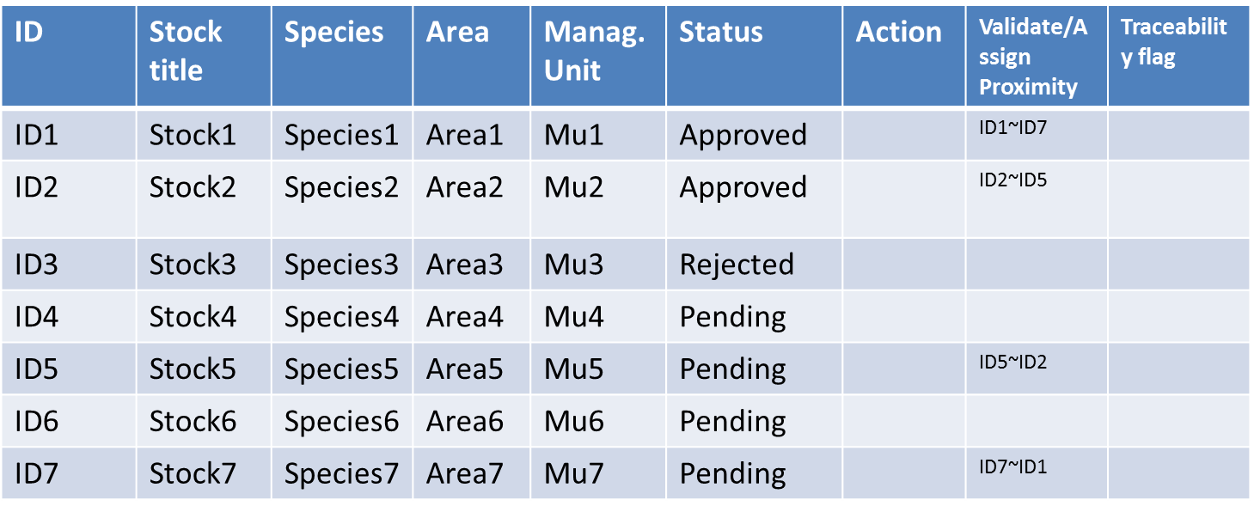
GRSF KB – Inspecting records
GRSF Records
X







Pending
Approve
Reject
Annotate

Slide 55
GRSF KB – Inspecting records
GRSF Records
X
 | ID | Stock title | Species | Area | Manag. Unit | Status
 | ID1 | Stock1 | Species1 | Area1 | Mu1 | Approved
 | ID2 | Stock2 | Species2 | Area2 | Mu2 | Approved
 | ID3 | Stock3 | Species3 | Area3 | Mu3 | Rejected
 | ID4 | Stock4 | Species4 | Area4 | Mu4 | Pending
 | ID5 | Stock5 | Species5 | Area5 | Mu5 | Pending
 | ID6 | Stock6 | Species6 | Area6 | Mu6 | Pending
 | ID7 | Stock7 | Species7 | Area7 | Mu7 | Pending


Approve
selected
Reject
selected

Slide 56
Exploiting (and updating) GRSF KB

Slide 57
Exploiting (and updating) GRSF KB
GRSF KB
  The knowledge base
MatWare-core
  A library that exposes the functionalities for the automation of the process of constructing a semantic web knowledge base
MatWare-webApp
  Allows the user to configure MatWare using a graphical user interface
    mappings, data source, semantic repositories, production of sameAs links, connectivity metrics

Slide 58
Exploiting (and updating) GRSF KB
GRSF-services-core
  A component (service/library) that exposes the contents of the GRSF KB
    i.e. RDF graph → lists of records
  Supports updating GRSF KB
    Approval/Rejection of GRSF records

Slide 59
Exploiting (and updating) GRSF KB
DataCatalogue
  A catalogue of datasets with metadata
DataCatalogue-Publish-API
  A software library responsible for publishing datasets and their corresponding metadata
DataCatalogue-webApp
  A web application responsible for exposing datasets and their accompanying descriptions from the DataCatalogue

Slide 62
Activities
Component | Status | Effort Estimation | Comments
GRSF KB | Ongoing | ~ 3 PMs | FORTH
MatWare-core | Ongoing | ~ 3 PMs | FORTH
MatWare-webApp | - | ~ 2 PMs | FORTH
GRSF-services-core | Ongoing | ~ 2 PMs | FORTH
DataCatalogue | ? | ? | CNR
DataCatalogue-webApp | ? | ? | CNR
DataCatalogue-Publish-API | ? | ? | ?

