Slide 1


GRSF
Global Record of Stocks and Fisheries
GRSF/RAMLDB Records areas (12 of October - 2022)
Standards and connection process

Slide 2
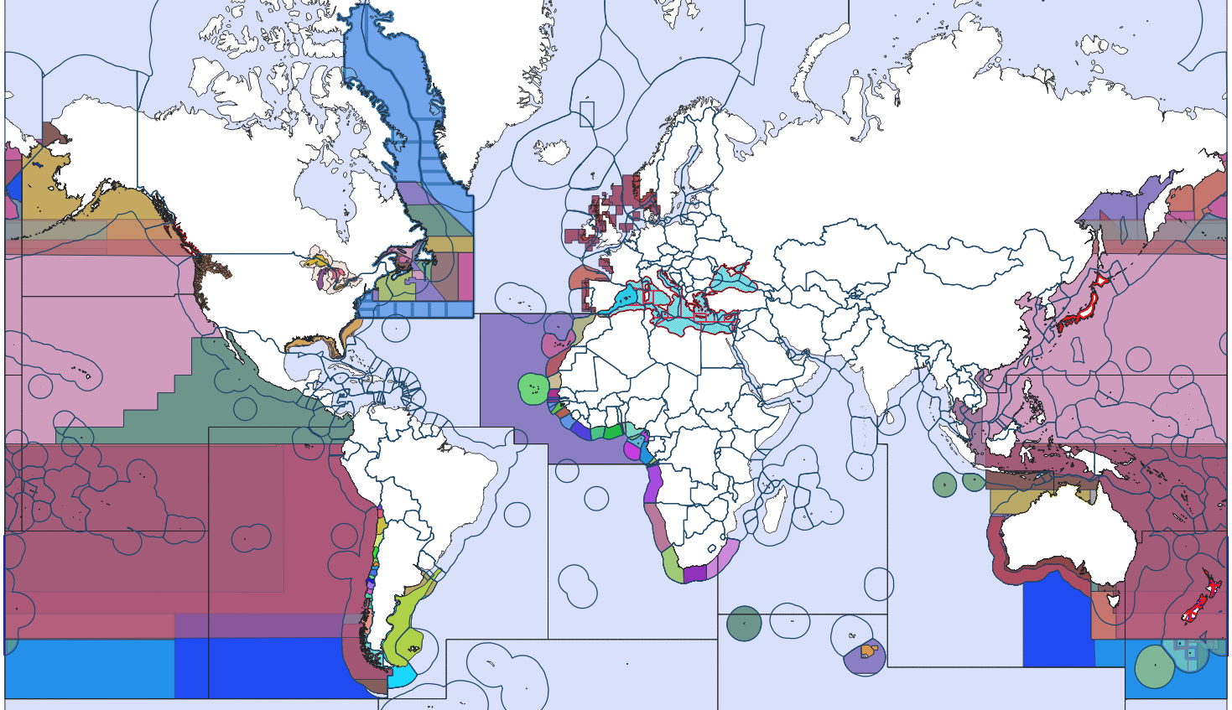

FAO&UW LoA – Areas definition
?
GRSF
Global Record of Stocks and Fisheries

Slide 3
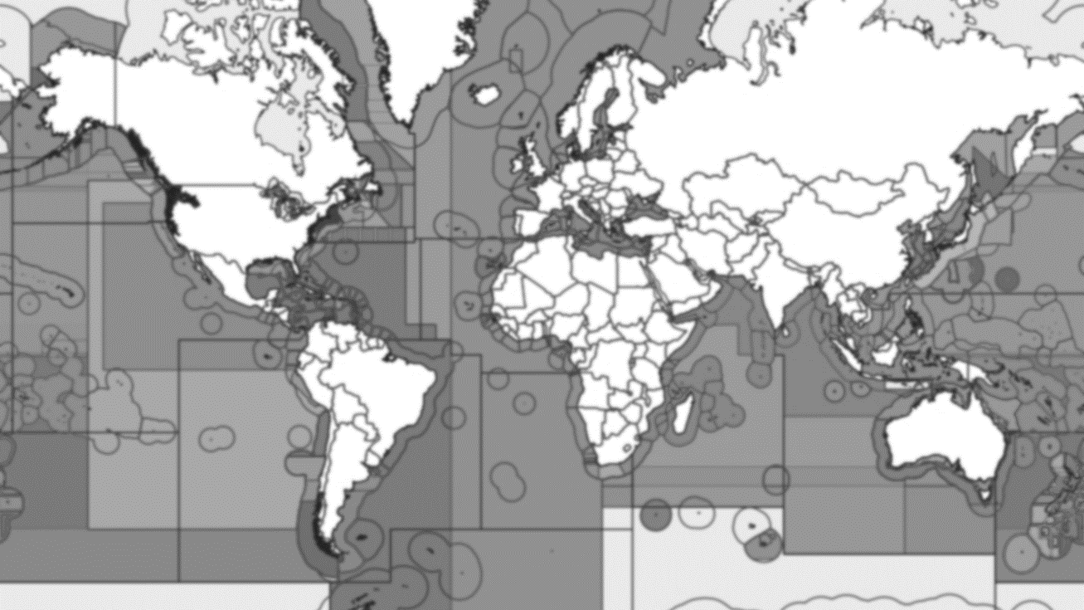


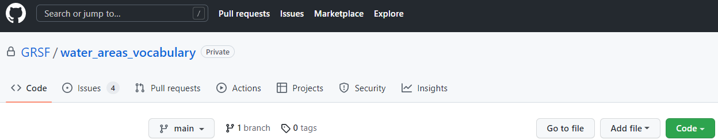
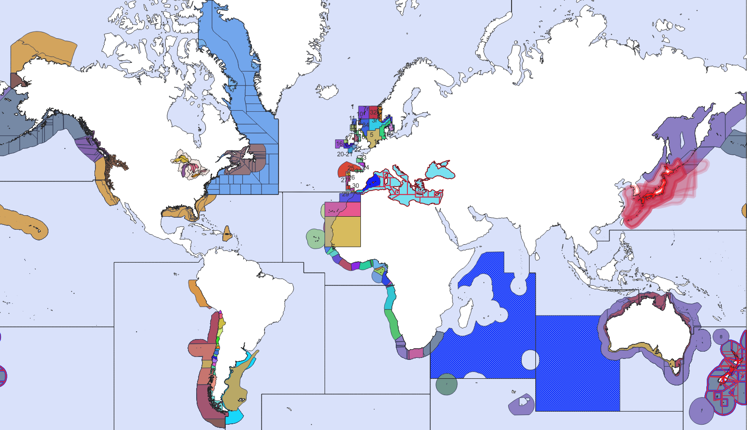
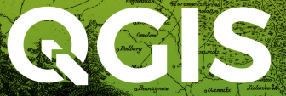
FAO&UW LoA – Areas definition
Records files
UUID
stockid
New GRSF area
“namespace”:”area_code”
RAMLDB
Including new areas
Namespace
&
area_code
Area metadata
georef_code
area_code
shapefile
Areas files
georef_code
area_code
Area polygon
Shapefiles
Attribute tables

Slide 4
FAO&UW LoA – Areas definition
Records files
UUID
stockid
New GRSF area
“namespace”:”area_code”
RAMLDB
Including new areas

Slide 5

FAO&UW LoA – Areas definition

Slide 6
FAO&UW LoA – Areas definition

Slide 7
FAO&UW LoA – Areas definition
Namespace
&
area_code
Area metadata
georef_code
area_code
shapefile
Areas files

Slide 8
FAO&UW LoA – Areas definition

Slide 9
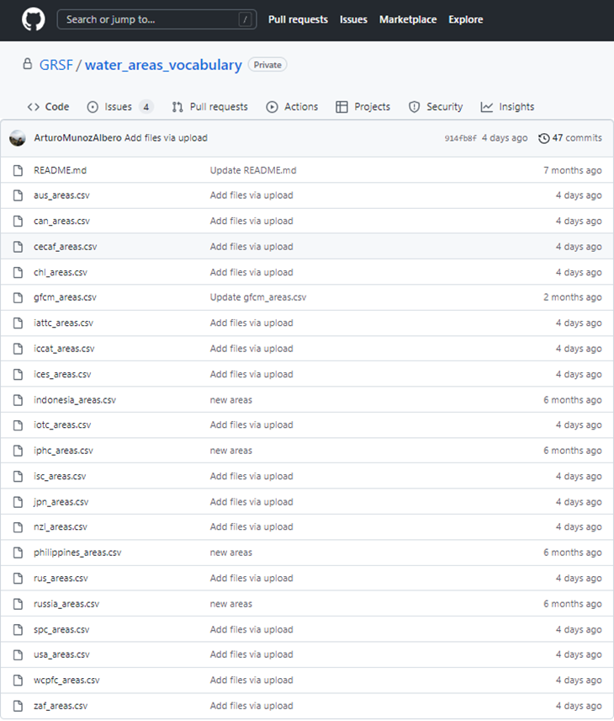
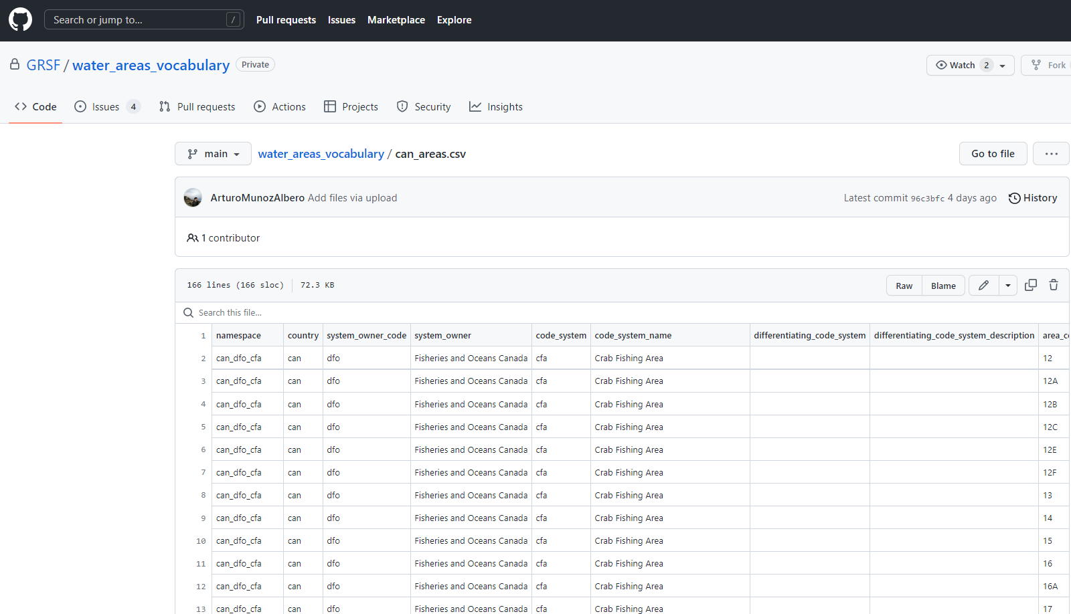
FAO&UW LoA – Areas definition

Slide 10
FAO&UW LoA – Areas definition
georef_code
area_code
Area polygon
Shapefiles
Attribute tables

Slide 11
FAO&UW LoA – Areas definition

Slide 12
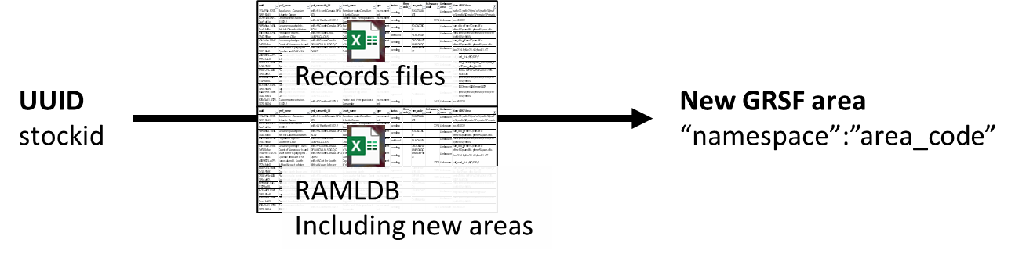
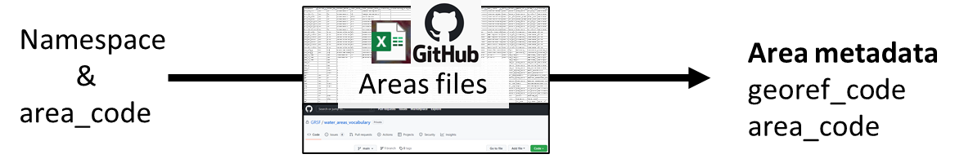
FAO&UW LoA – Areas definition (example 1)

Slide 13
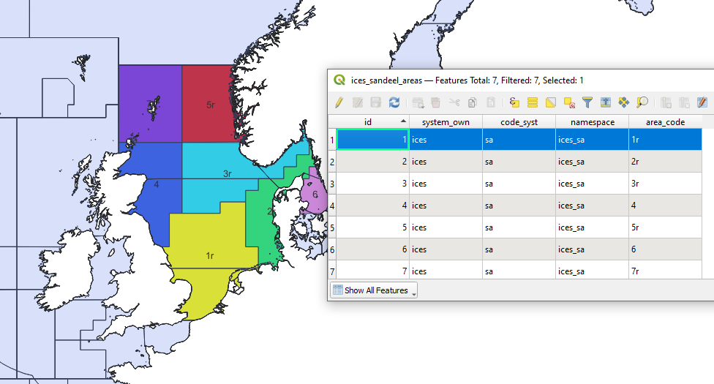
FAO&UW LoA – Areas definition (example 1)

Slide 14
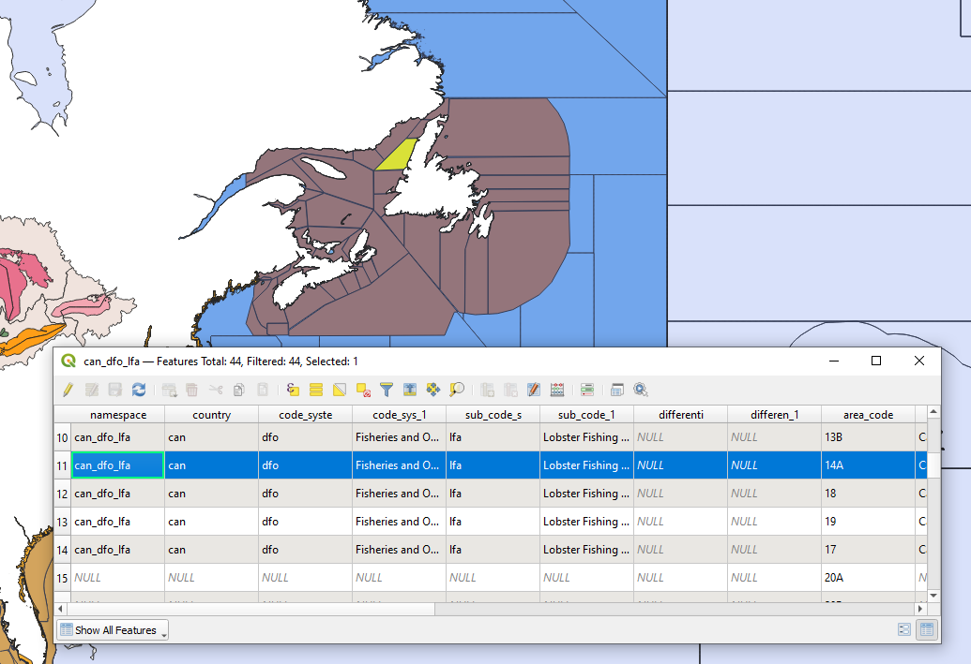
FAO&UW LoA – Areas definition (example 2)

Slide 15


FAO&UW LoA – Areas definition
Records files
UUID
stockid
New GRSF area
“namespace”:”area_code”
RAMLDB
Including new areas
Namespace
&
area_code
Area metadata
georef_code
area_code
shapefile
Areas files
Fish in Space Database
georef_code
area_code
Area polygon
Shapefiles
Attribute tables

Slide 16
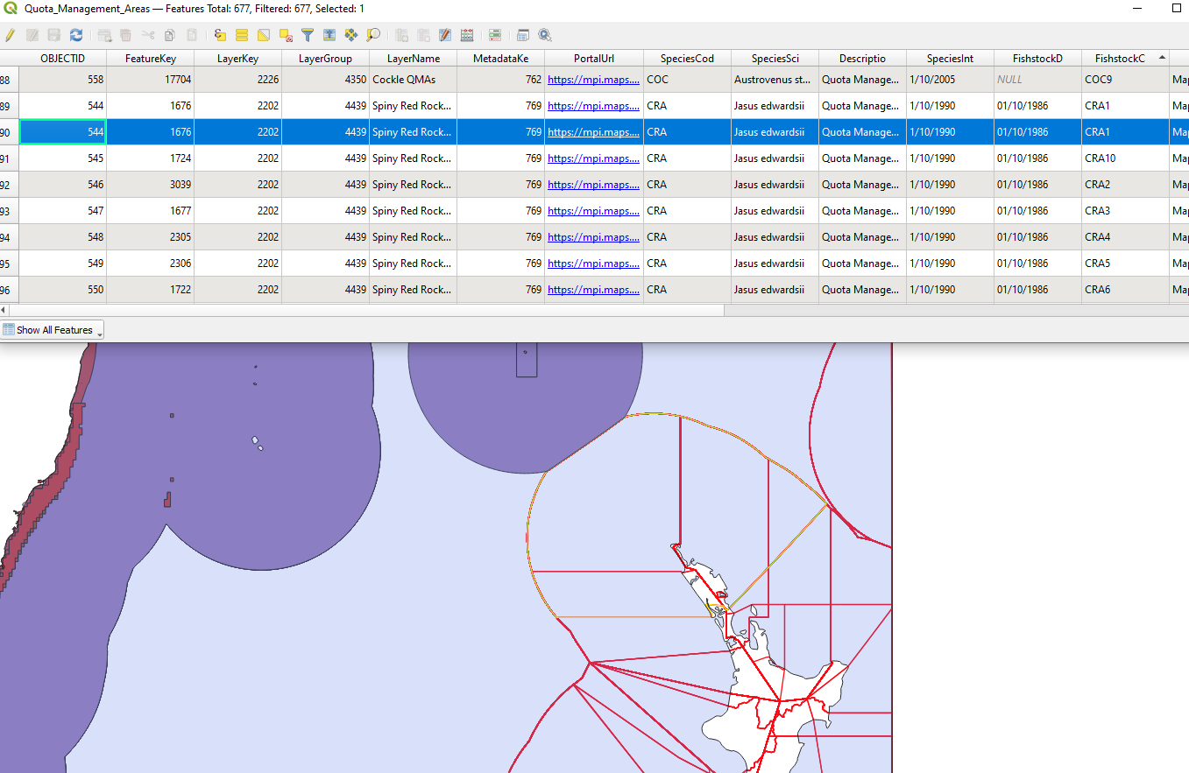
FAO&UW LoA – Areas definition (example 3)

Slide 17


FAO&UW LoA – Areas definition
UUID
RAM stockid
Records files
UUID
stockid
New GRSF area
“namespace”:”area_code”
RAMLDB
RAMLDB
Including new areas
New GRSF area
“namespace”:”area_code”
Namespace
&
area_code
Area metadata
georef_code
area_code
shapefile
Areas files
Fish in Space Database
Area metadata
georef_code
area_code
shapefile
georef_code
area_code
Area polygon
Official databases
Shapefiles
Attribute tables
Area polygon

