Slide 1
Constructing and Exploiting GRSF
FORTH-ICS
BlueBRIDGE
June 29, 2016

Slide 2
The process
Web products
(map viewer, pie charts for regional stock status, etc.)
FIRMS
RAM
FishSource
GRSF KB
Web services
GRSF records
CMS

Slide 3












The Construction phase
GRSF
KB
X3ML eng

Slide 5
Constructing the GRSF KB
The knowledge base will be a set of triples <s,p,o>
Components required
  MatWare and plugins (under development)
    mappings, data fetching, transformations, ingestion, sameAs links
  MatWare front-end (to be developed)
    Assisting the user (VRE manager) to configure MatWare

Slide 6
Exploiting (and updating) GRSF KB
Requirements
  Inspect the set of records
    i.e. as tabular data (some mockups are given later)
  Support the competency queries
  Be able to approve/reject records
    Also attach a justification for (at least) rejected records
  Flag possible errors

Slide 7
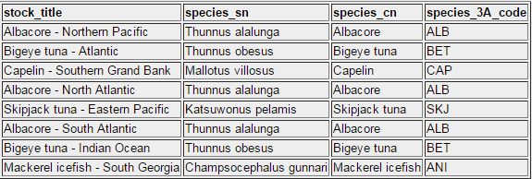
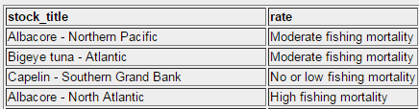
Exploiting (and updating) GRSF KB
Screenshots / mockups

Slide 8
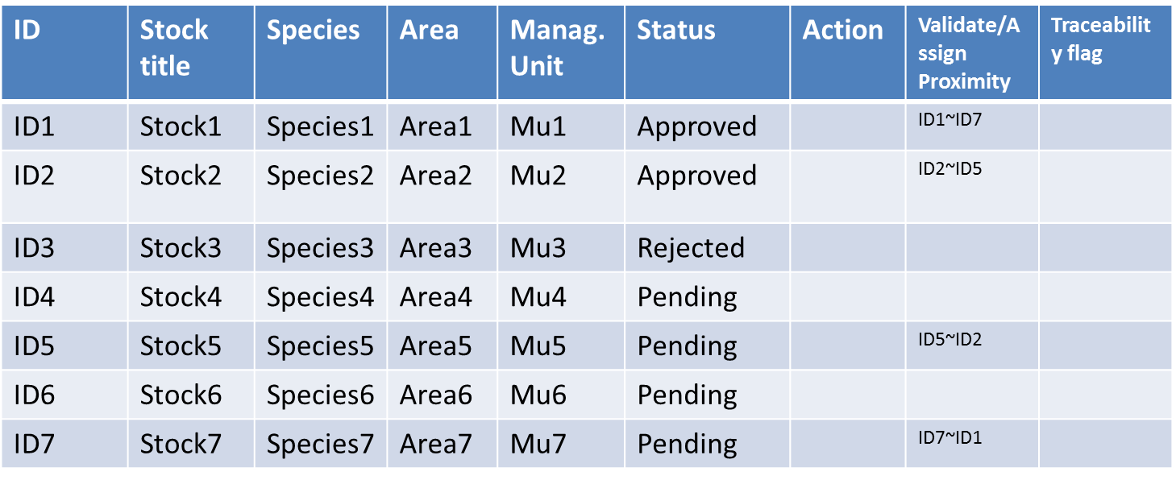
GRSF KB – Inspecting records
GRSF Records
X







Pending
Approve
Reject
Annotate

Slide 9
GRSF KB – Inspecting records
GRSF Records
X
 | ID | Stock title | Species | Area | Manag. Unit | Status
 | ID1 | Stock1 | Species1 | Area1 | Mu1 | Approved
 | ID2 | Stock2 | Species2 | Area2 | Mu2 | Approved
 | ID3 | Stock3 | Species3 | Area3 | Mu3 | Rejected
 | ID4 | Stock4 | Species4 | Area4 | Mu4 | Pending
 | ID5 | Stock5 | Species5 | Area5 | Mu5 | Pending
 | ID6 | Stock6 | Species6 | Area6 | Mu6 | Pending
 | ID7 | Stock7 | Species7 | Area7 | Mu7 | Pending


Approve
selected
Reject
selected

Slide 10
Exploiting (and updating) GRSF KB

Slide 11
Exploiting (and updating) GRSF KB
GRSF KB
  The knowledge base
MatWare-core
  A library that exposes the functionalities for the automation of the process of constructing a semantic web knowledge base
MatWare-webApp
  Allows the user to configure MatWare using a graphical user interface
    mappings, data source, semantic repositories, production of sameAs links, connectivity metrics

Slide 12
Exploiting (and updating) GRSF KB
GRSF-services-core
  A component (service/library) that exposes the contents of the GRSF KB
    i.e. RDF graph → lists of records
  Supports updating GRSF KB
    Approval/Rejection of GRSF records
GRSF-services-webApp
  Provides a graphical user interface that allows a user to inspect the GRSF records (by exploiting GRSF-services-core) and change their status correspondingly.

Slide 13
Exploiting (and updating) GRSF KB

Slide 14
Activities
Component | Status | Effort Estimation | Comments
GRSF KB | Ongoing | ~ 3 PMs | FORTH
MatWare-core | Ongoing | ~ 3 PMs | FORTH
MatWare-webApp | - | ~ 2 PMs | FORTH
GRSF-services-core | Ongoing | ~ 2 PMs | FORTH
GRSF-services-webApp | - | ~ 2 PMs (?) | ?

